Slide 1
Introduction to sc/snRNA-seq & visualization with R shiny applications
Sharon Freshour, PhD Bioinformatics Research Scientist
Bioinformatics Core
Department of Developmental Neurobiology
St. Jude Children’s Research Hospital
September 18th, 2024

Slide 2


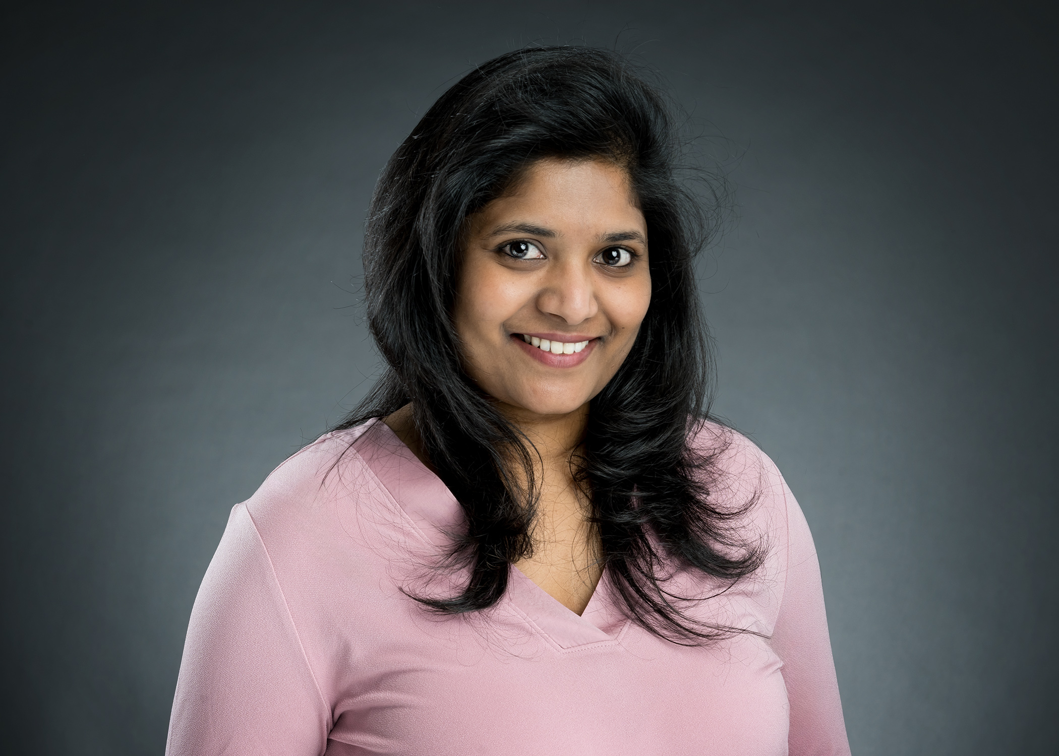
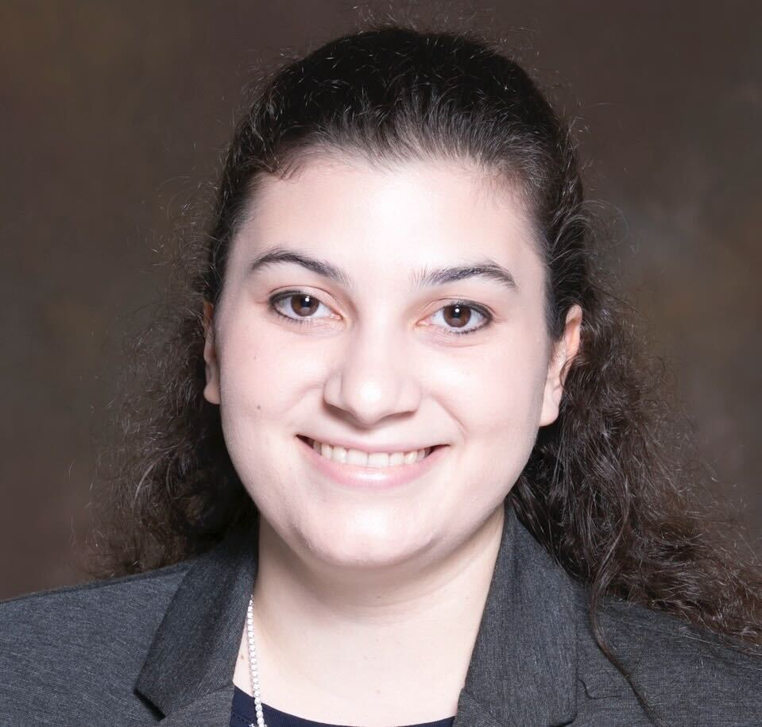
The DNB Bioinformatics Core Team
Cody Ramirez, Ph.D.
Antonia Chroni, Ph.D.
Asha Jannu, Ph.D.
Sharon Freshour, Ph.D.
Senior Bioinformatics Research Scientist
Core Director
Boston, Massachusetts
Senior Bioinformatics Research Scientist
New York, New York
Bioinformatics Research Scientist
Indianapolis, Indiana
Bioinformatics Research Scientist
St. Louis, Missouri

Slide 3
Intro to sc/snRNA-seq Workshop Overview
Single cell (scRNA-seq) vs single nuclear (snRNA-seq) RNA sequencing
sc/snRNA-seq library preparation
Raw sequencing QC (FastQC)
Alignment QC (CellRanger)
Cell-level filtering (Seurat)
Short break for everyone to get their lunch
Visualization with R Shiny

Slide 4
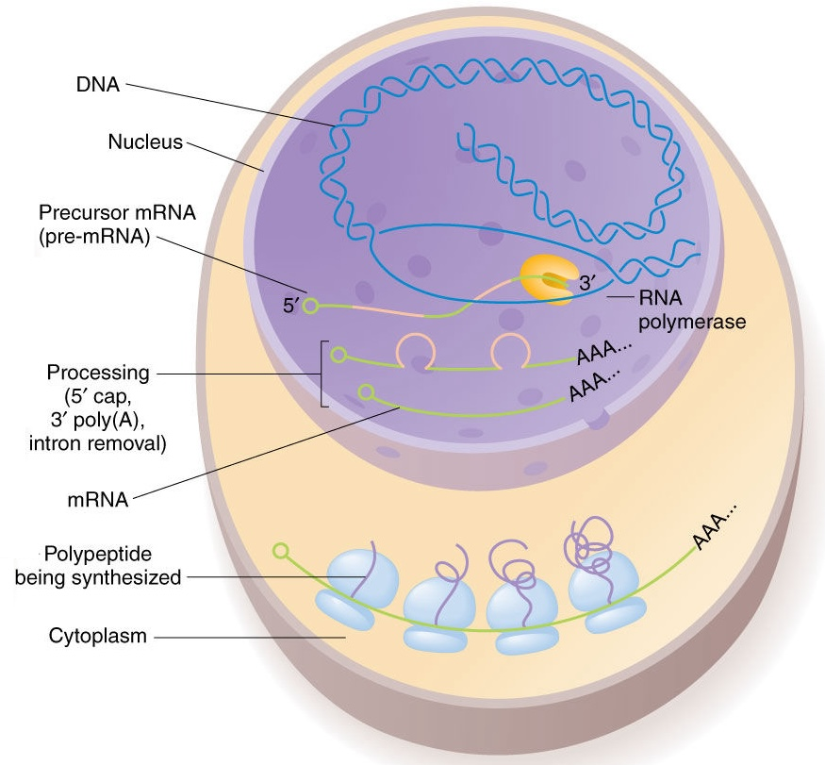
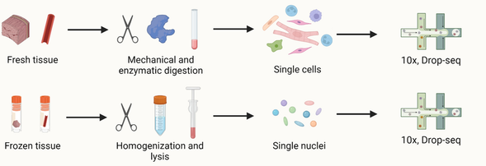
scRNA-seq versus snRNA-seq
 | scRNA-seq​ | snRNA-seq​
Portion of cell:​ | Entire cell​ | Nuclei​
Transcripts measured:​ | Cytoplasmic + nuclear​ | Nuclear​
Pre-mRNA %:​ | Lower​ | Higher​
mRNA %:​ | Higher​ | Lower​
Exonic %:​ | Higher​ | Lower​
Intronic %:​ | Lower​ | Higher​
More appropriate for:​ | Fresh​ | Preserved or isolation difficulties​
Xu, Xinjie, et al. DOI: 10.1007/s00395-022-00972-1.
©️ 2010 Pearson Education, Inc.
Notes:
snRNA-seq uses isolated nuclei instead of the entire cells to profile gene expression. That is to say, scRNA-seq measures both cytoplasmic and nuclear transcripts, while snRNA-seq mainly measures nuclear transcripts (though some transcripts might be attached to the rough endoplasmic reticulum and partially preserved in nuclear preps).[7] This allows for snRNA-seq to process only the nucleus and not the entire cell. For this reason, compared to scRNA-seq, snRNA-Seq is more appropriate to profile gene expression in cells that are difficult to isolate (e.g. adipocytes, neurons), as well as preserved tissues.[5]​
Additionally, the nuclei required for snRNA-seq can be obtained quickly and easily from fresh, lightly fixed, or frozen tissues, whereas isolating single cells for single-cell RNA-seq (scRNA-seq) involves extended incubations and processing. This gives researchers the ability to obtain transcriptomes which are not as perturbed during isolation.

Slide 5
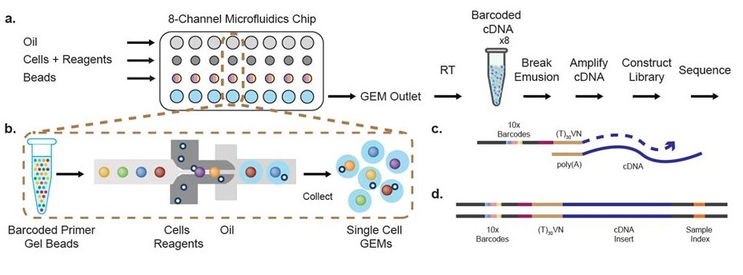
10x Genomics sc/snRNA-seq platform
Zheng, G., Terry, J., Belgrader, P. et al. DOI: 10.1038/ncomms14049
Notes:
10x Genomics Single Cell Features​
Workflow from single cell suspensions.​
8-channel microfluidic chip allowing up to 8 samples to be processed simultaneously. Samples are barcoded individually for a multiplexed sequencing reaction.​
10x Chromium instrument capable of capturing 100 to 10,000 cells per sample; up to 80,000 cells per chip in ~7 minutes.​
Recovers up to 65% of cells (typically closer to 50% depending on cell type)​
Low doublet rate: ~0.8% per 1,000 cells; ~1.6% per 2,000 cells; ~2.3% per 3,000 cells; ~3.1% per 4,000 cells; ~3.9% per 5,000 cells; etc.​
50,000 reads per cell should be sequenced for saturating gene detection. 70,000 reads per cell is appropriate for expression analysis.​
Nuclei suspension can also be prepared and sequenced.​
​
(a) scRNA-seq workflow on GemCode technology platform. Cells were combined with reagents in one channel of a microfluidic chip, and gel beads from another channel to form GEMs. RT takes place inside each GEM, after which cDNAs are pooled for amplification and library construction in bulk. (b) Gel beads loaded with primers and barcoded oligonucleotides are first mixed with cells and reagents, and subsequently mixed with oil-surfactant solution at a microfluidic junction. Single-cell GEMs are collected in the GEM outlet. (c) Gel beads contain barcoded oligonucleotides consisting of Illumina adapters, 10x barcodes, UMIs and oligo dTs, which prime RT of polyadenylated RNAs. (d) Finished library molecules consist of Illumina adapters and sample indices, allowing pooling and sequencing of multiple libraries on a next-generation short read sequencer.

Slide 6
Quality control of raw sequencing data
with FastQC
Notes:
https://www.bioinformatics.babraham.ac.uk/projects/fastqc/
https://www.bioinformatics.babraham.ac.uk/projects/fastqc/Help/3%20Analysis%20Modules/

Slide 7
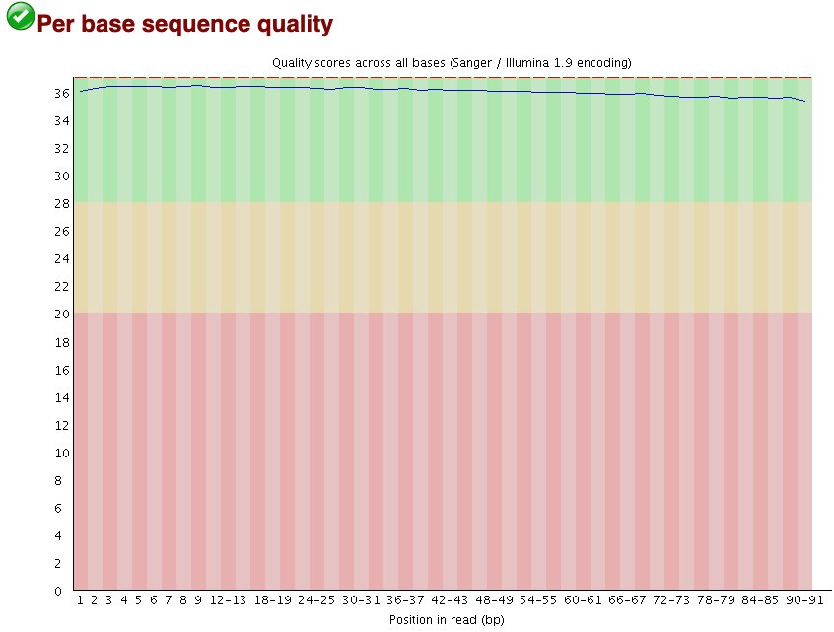

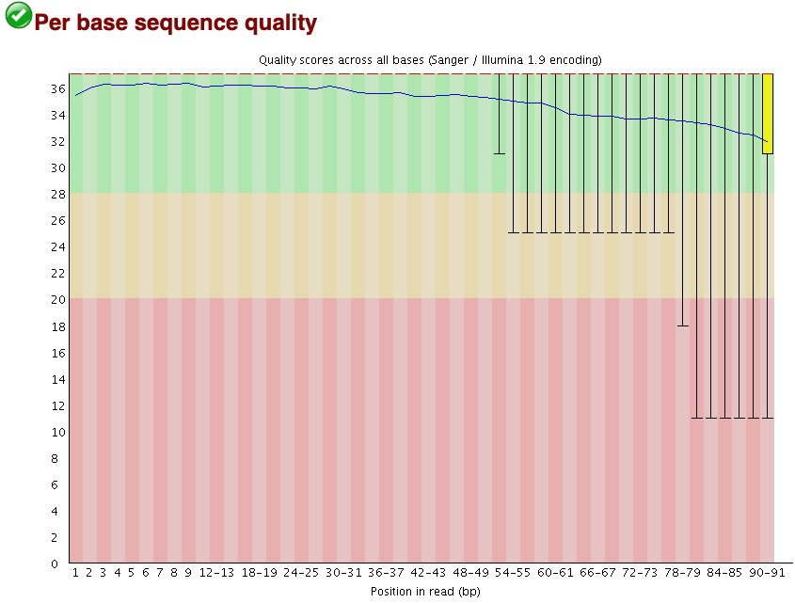
Per base sequence quality indicates the sequencing quality scores at each base position
Gold standard
10x Genomics scRNA-seq
Salvageable?
Patient sample snRNA-seq
Fail
Organoid sample snRNA-seq
Notes:
Phred scores (quality scores) below 30 are considered unreliable, Q30 corresponds to 99.9% base call accuracy, 1 in 1000 probability of incorrect call
Q20 is 99% accurate, 1 in 100 probability of missed call, Q40 99.99%, 1 in 10,000
For each position a BoxWhisker type plot is drawn. The elements of the plot are as follows:
The central red line is the median value
The yellow box represents the inter-quartile range (25-75%)
The upper and lower whiskers represent the 10% and 90% points
The blue line represents the mean quality

Slide 8
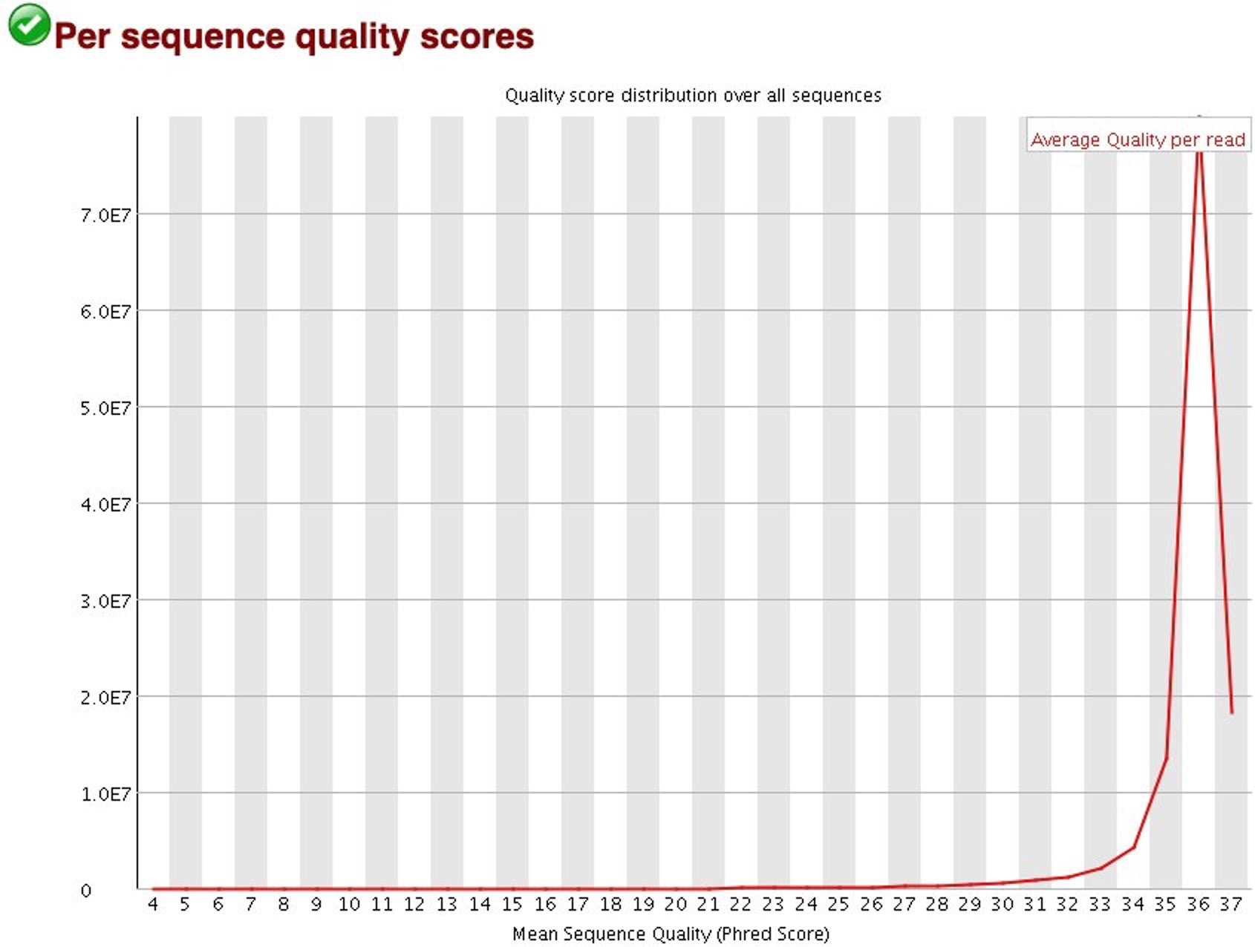
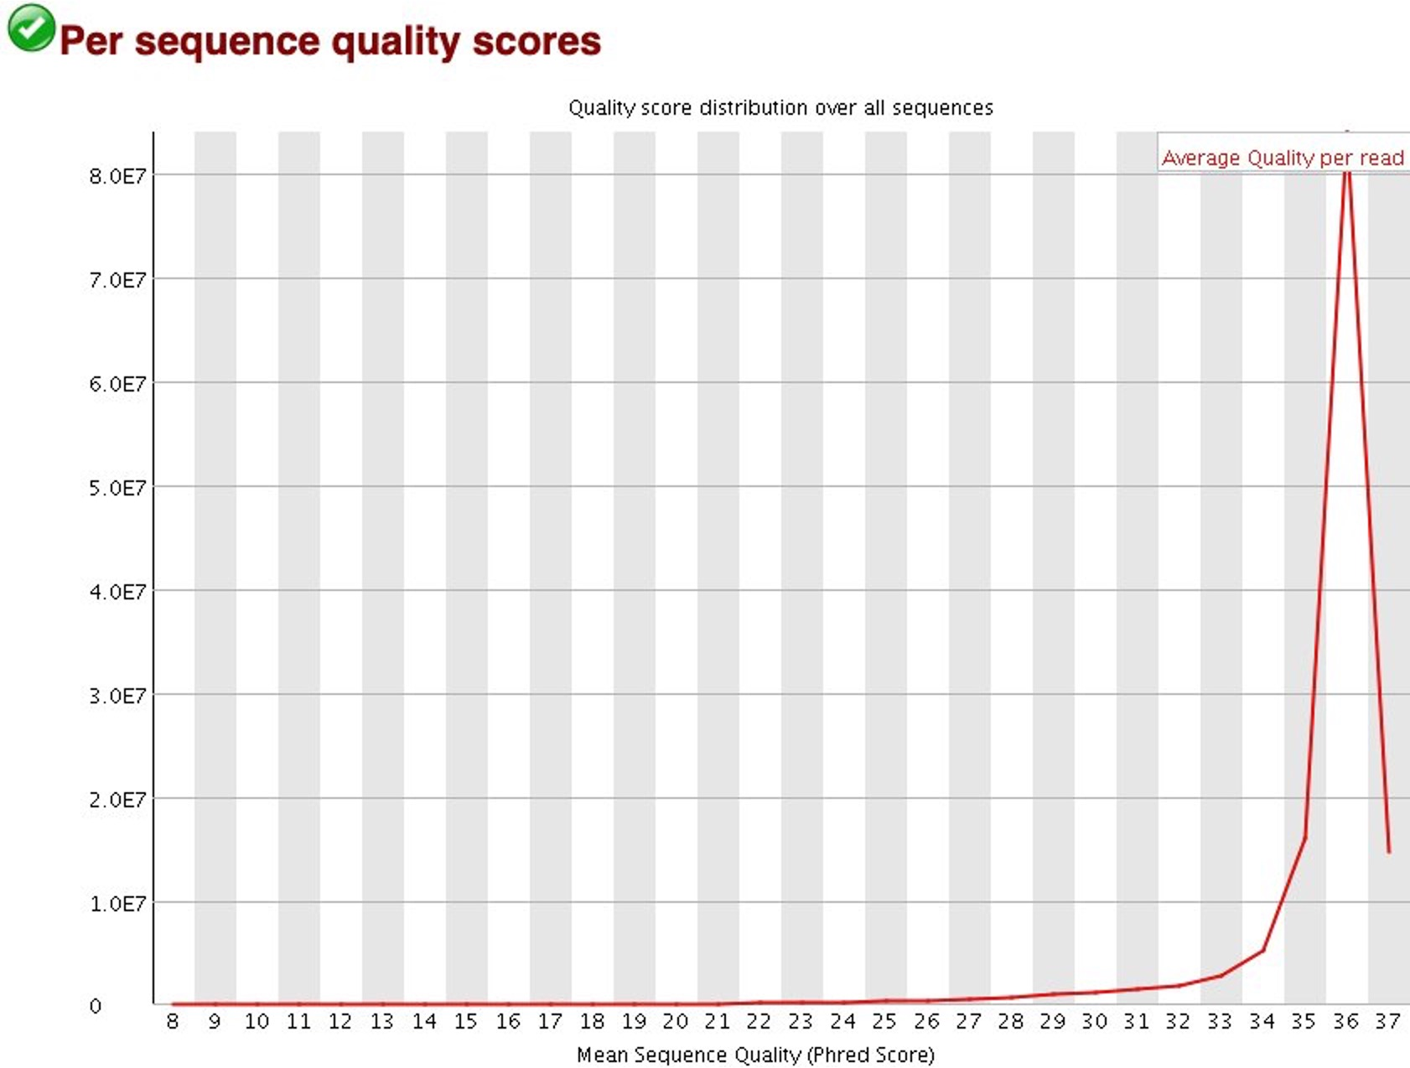
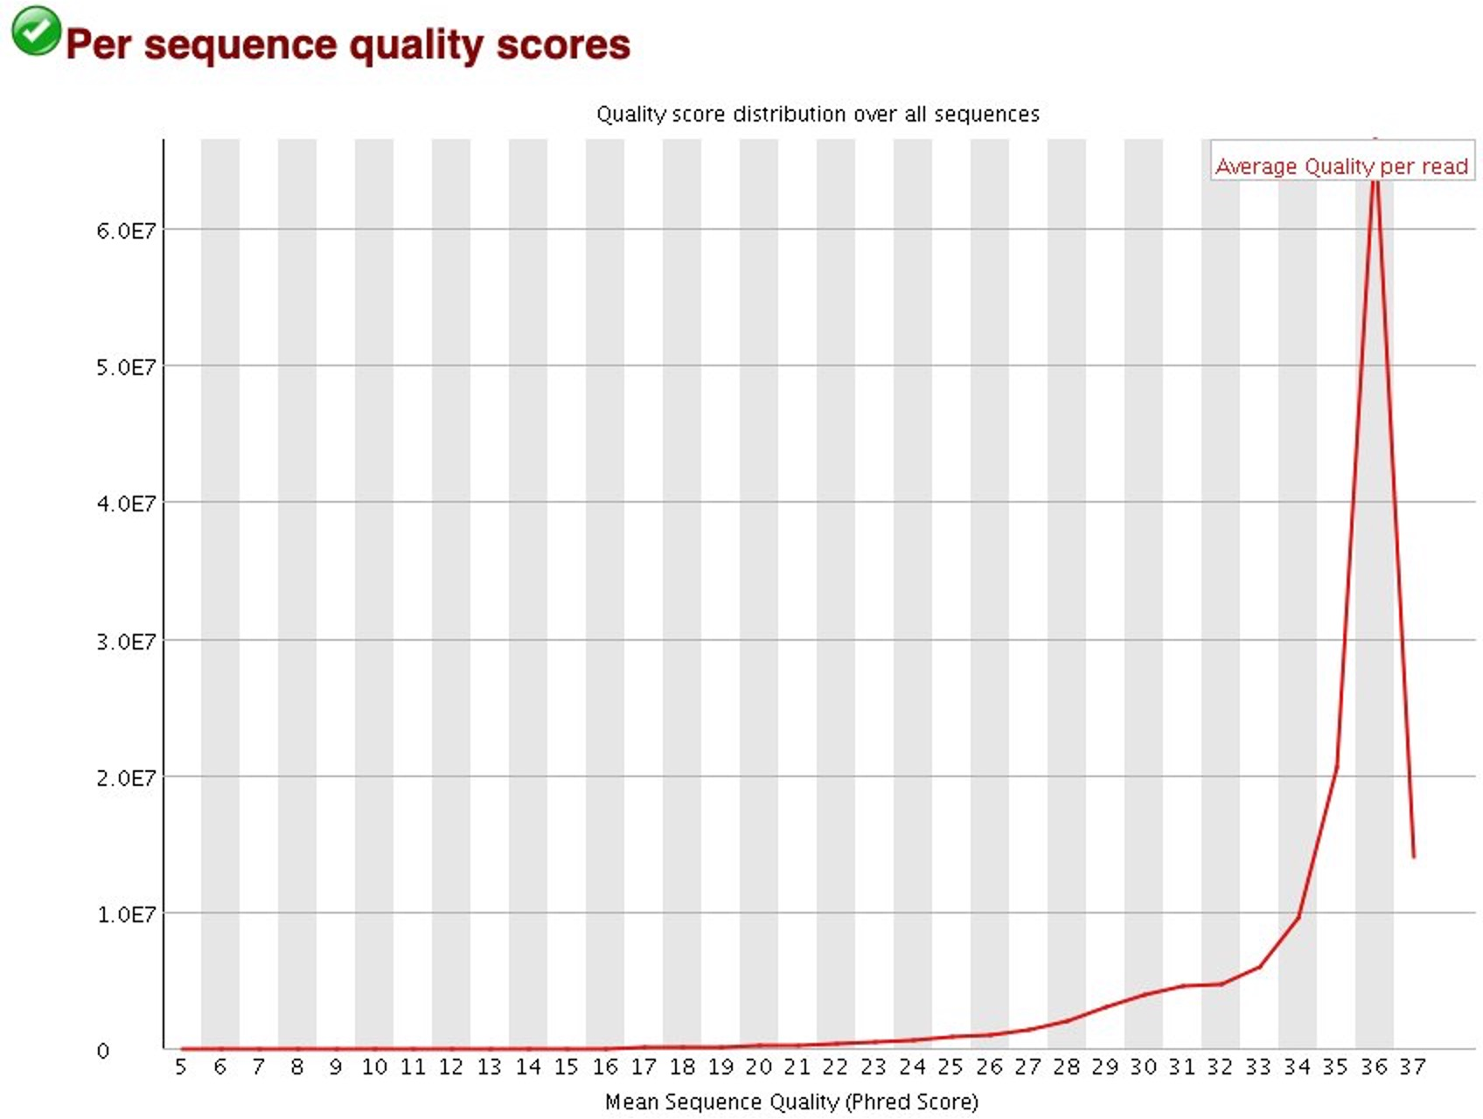
Per sequence quality scores indicate if sequences have poor quality across sequencing run
Gold standard
10x Genomics scRNA-seq
Salvageable?
Patient sample snRNA-seq
Fail
Organoid sample snRNA-seq

Slide 9
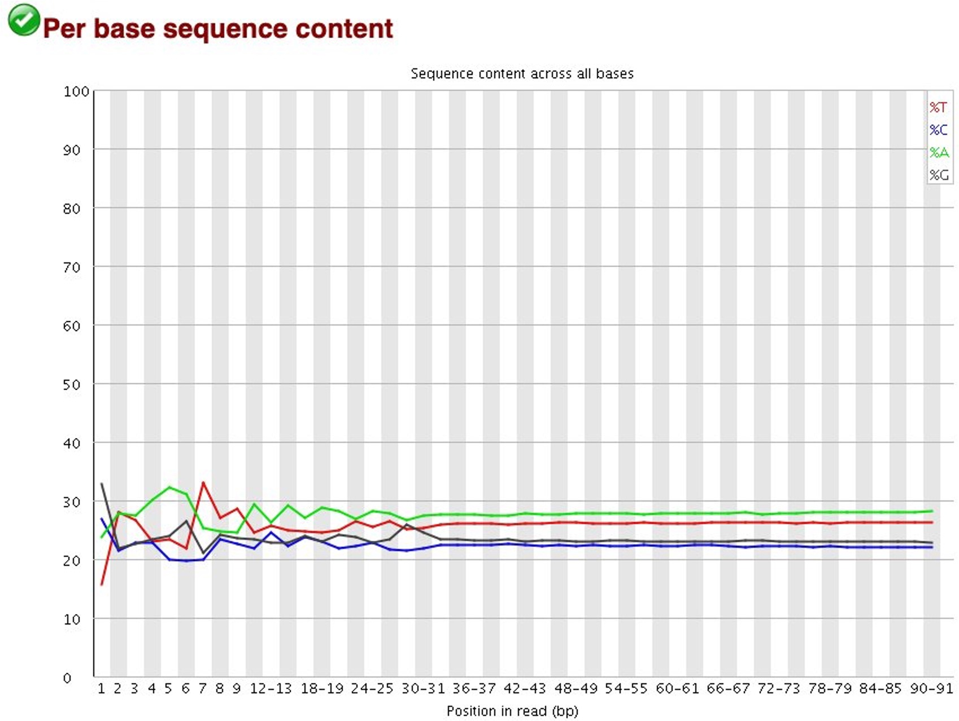
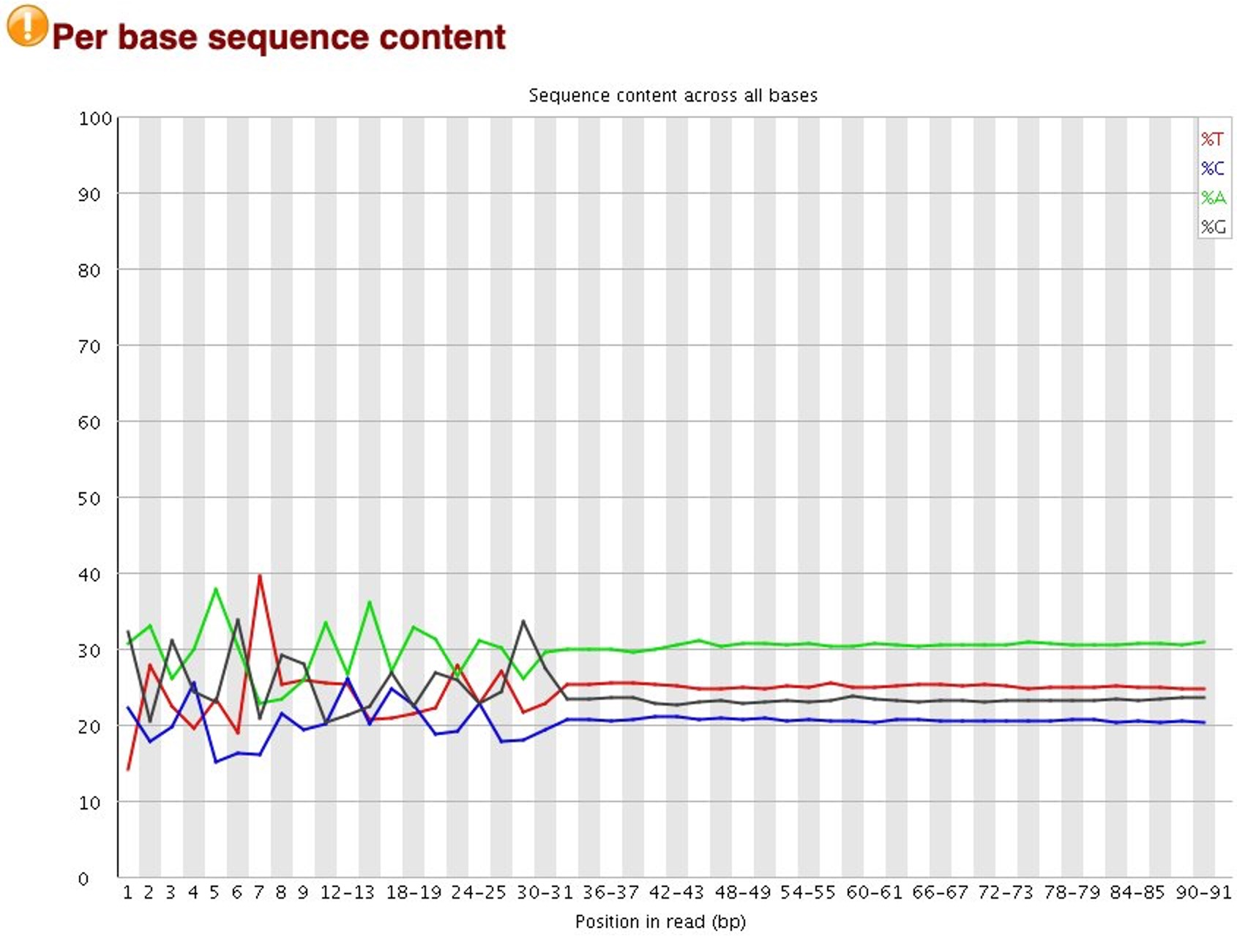
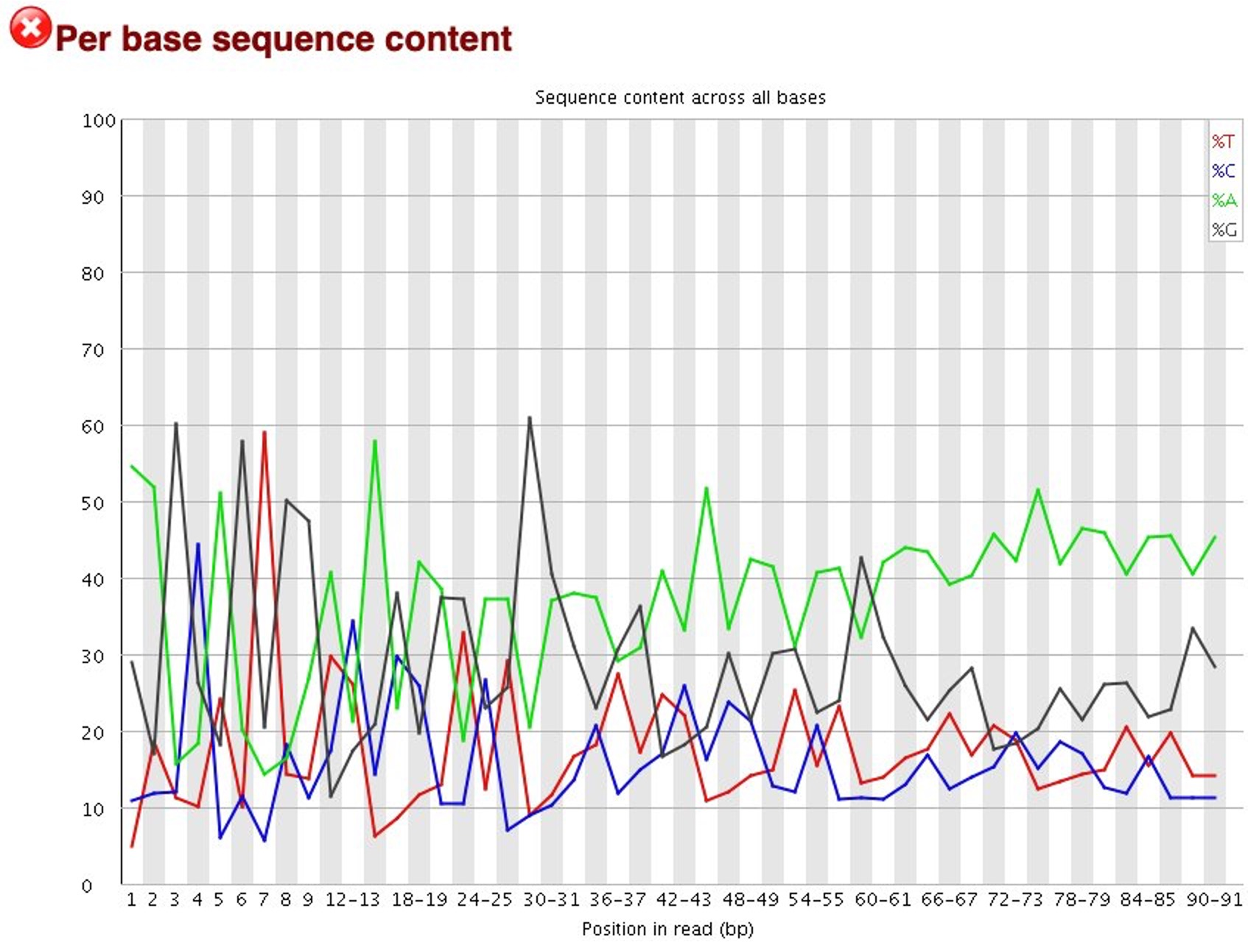
Per base sequence content indicates if there is (unexpected) bias in the proportion of bases called
Gold standard
10x Genomics scRNA-seq
Salvageable?
Patient sample snRNA-seq
Fail
Organoid sample snRNA-seq
Notes:
There are several reasons that you see unexpected proportions, including overrepresented sequences which can be cause by adapter dimers or primer dimers
For example, if adapters or primers anneal to the template DNA during sequencing then the raw sequencing will include these false reads and change the proportion of bases called
There are a number of common scenarios which would ellicit a warning or error from this module.
Overrepresented sequences: If there is any evidence of overrepresented sequences such as adapter dimers or rRNA in a sample then these sequences may bias the overall composition and their sequence will emerge from this plot.
Biased fragmentation: Any library which is generated based on the ligation of random hexamers or through tagmentation should theoretically have good diversity through the sequence, but experience has shown that these libraries always have a selection bias in around the first 12bp of each run. This is due to a biased selection of random primers, but doesn't represent any individually biased sequences. Nearly all RNA-Seq libraries will fail this module because of this bias, but this is not a problem which can be fixed by processing, and it doesn't seem to adversely affect the ablity to measure expression.
Biased composition libraries: Some libraries are inherently biased in their sequence composition. The most obvious example would be a library which has been treated with sodium bisulphite which will then have converted most of the cytosines to thymines, meaning that the base composition will be almost devoid of cytosines and will thus trigger an error, despite this being entirely normal for that type of library
If you are analysing a library which has been aggressivley adapter trimmed then you will naturally introduce a composition bias at the end of the reads as sequences which happen to match short stretches of adapter are removed, leaving only sequences which do not match. Sudden deviations in composition at the end of libraries which have undergone aggressive trimming are therefore likely to be spurious.

Slide 10
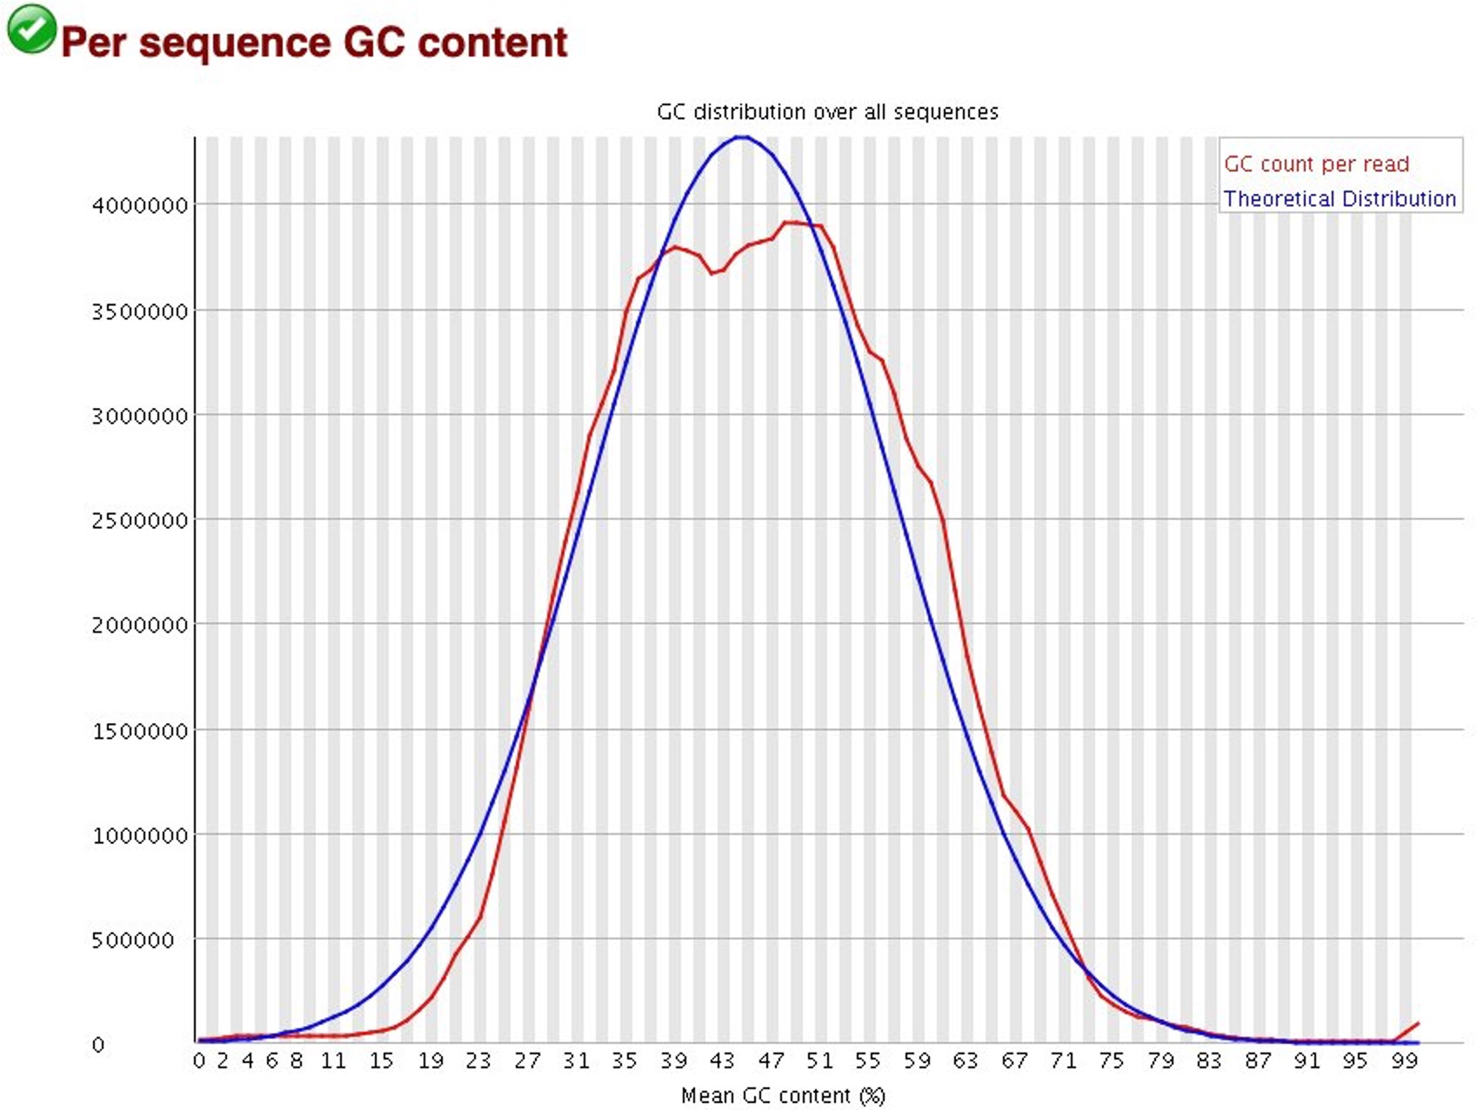
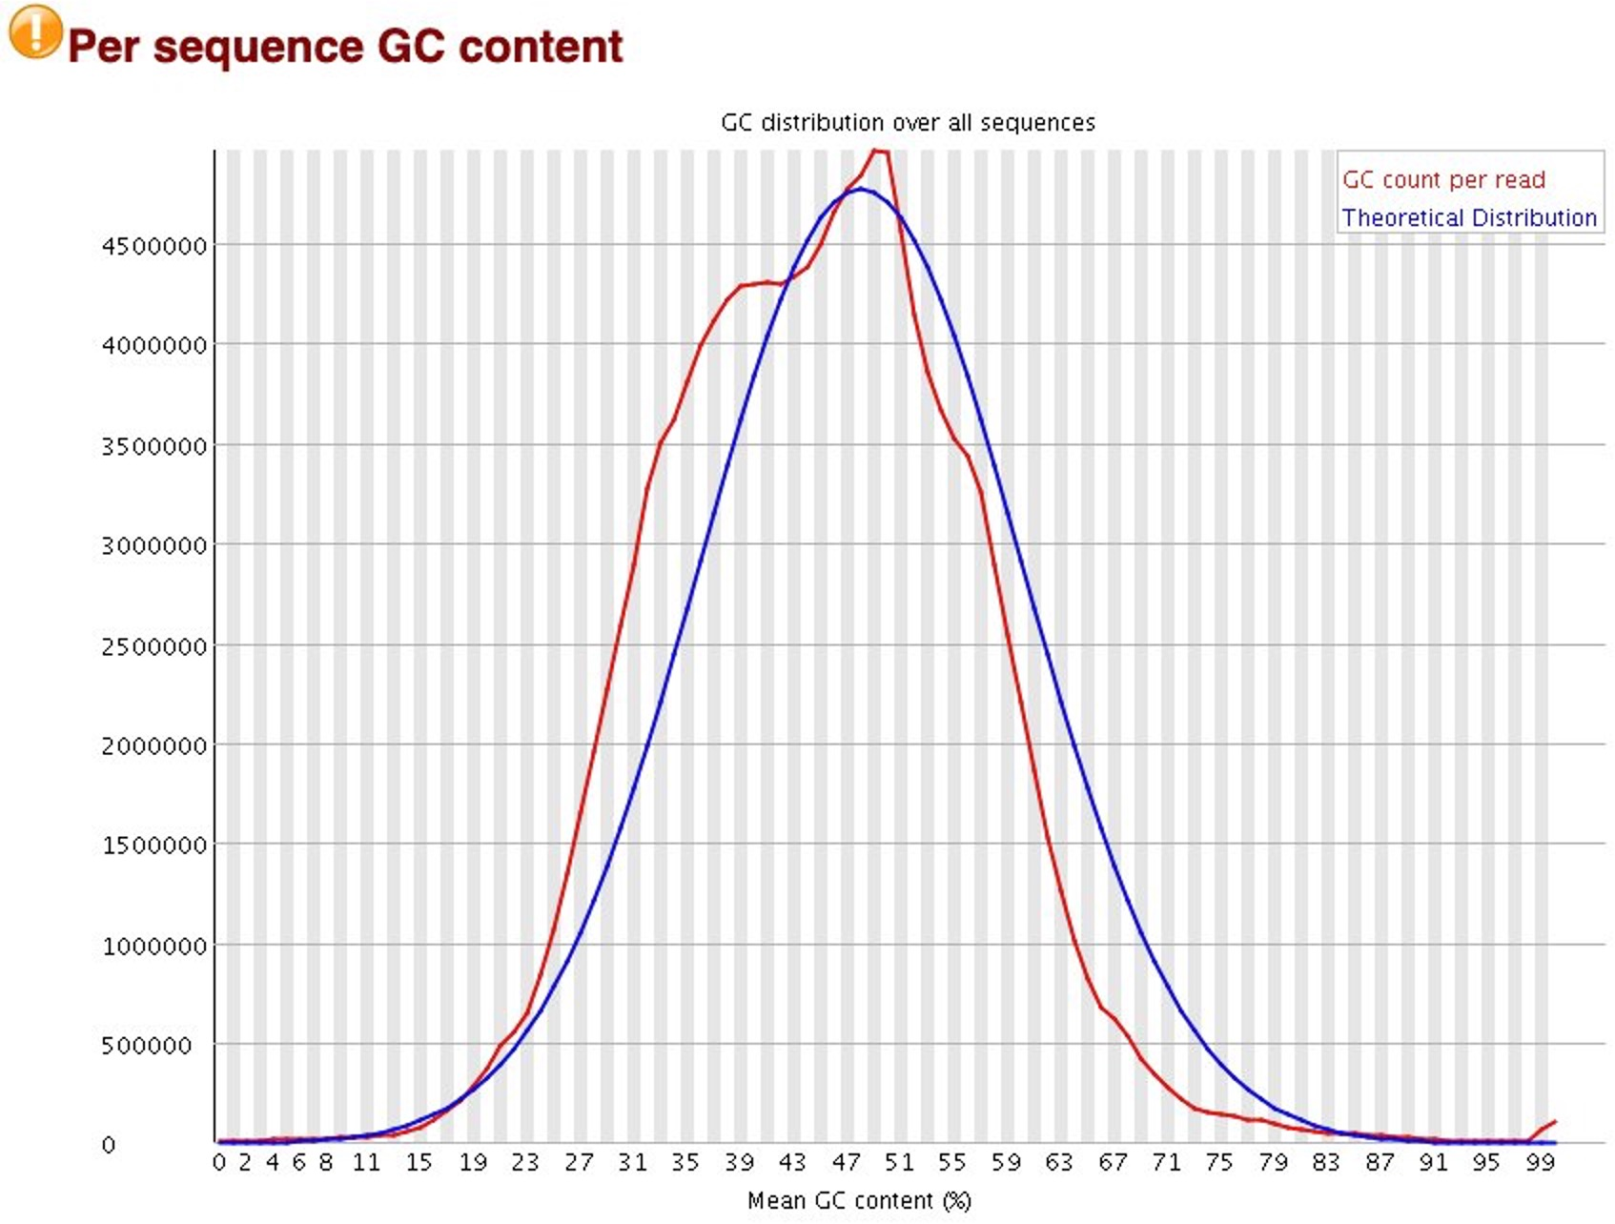
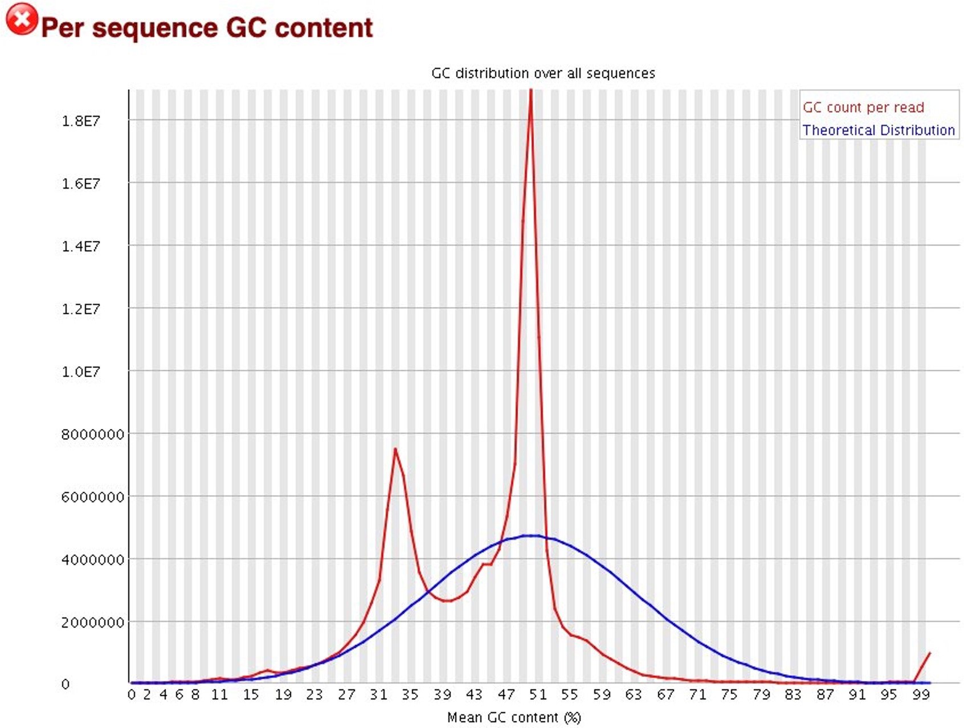
Per sequence GC content indicates if distribution of GC content is non-normal
Gold standard
10x Genomics scRNA-seq
Salvageable?
Patient sample snRNA-seq
Fail
Organoid sample snRNA-seq
Notes:
Warnings in this module usually indicate a problem with the library. Sharp peaks on an otherwise smooth distribution are normally the result of a specific contaminant (adapter dimers for example), which may well be picked up by the overrepresented sequences module. Broader peaks may represent contamination with a different species.

Slide 11
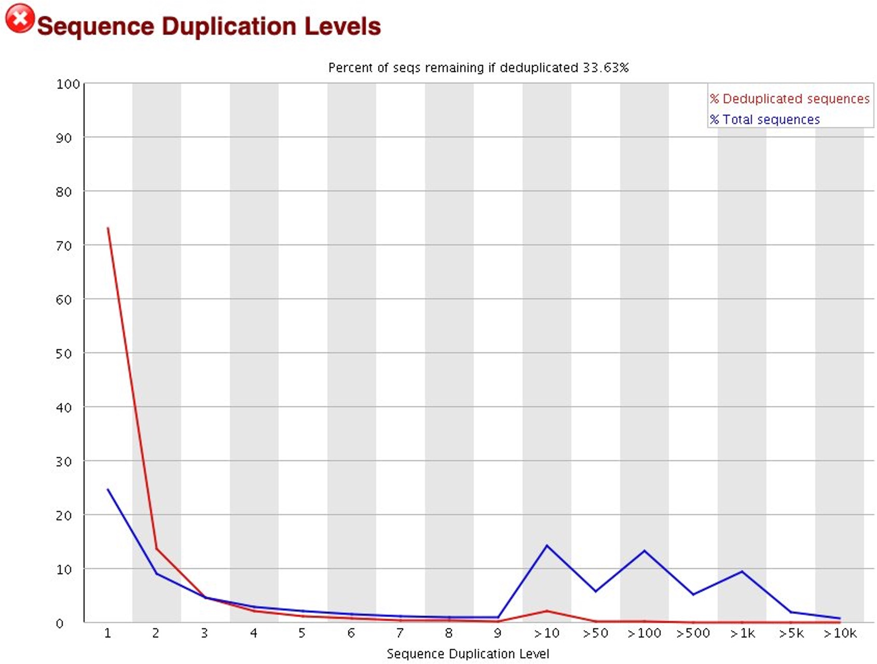
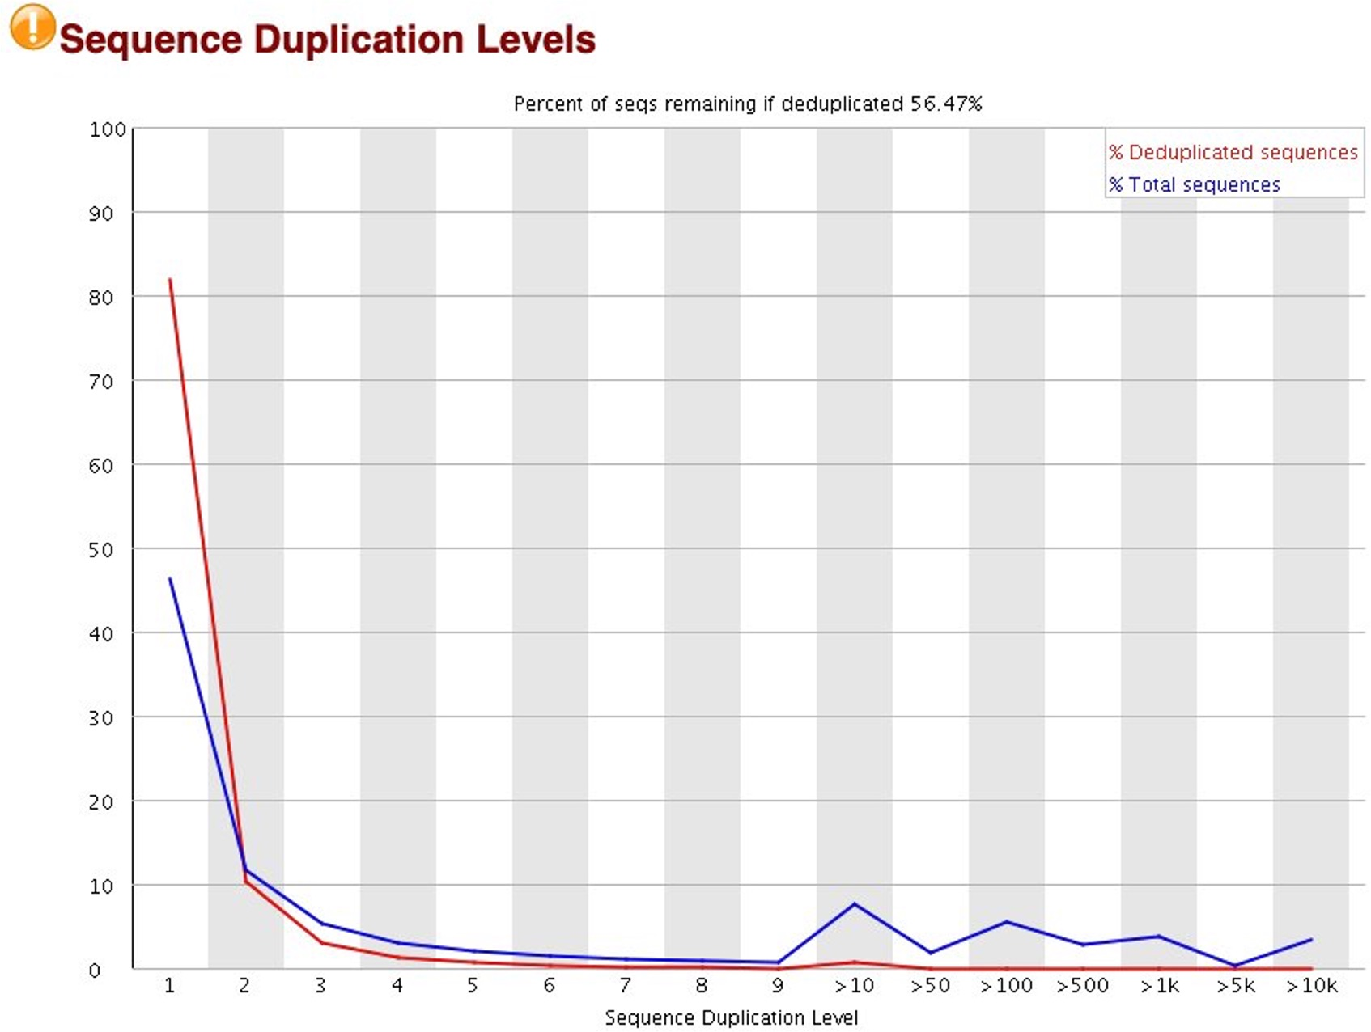
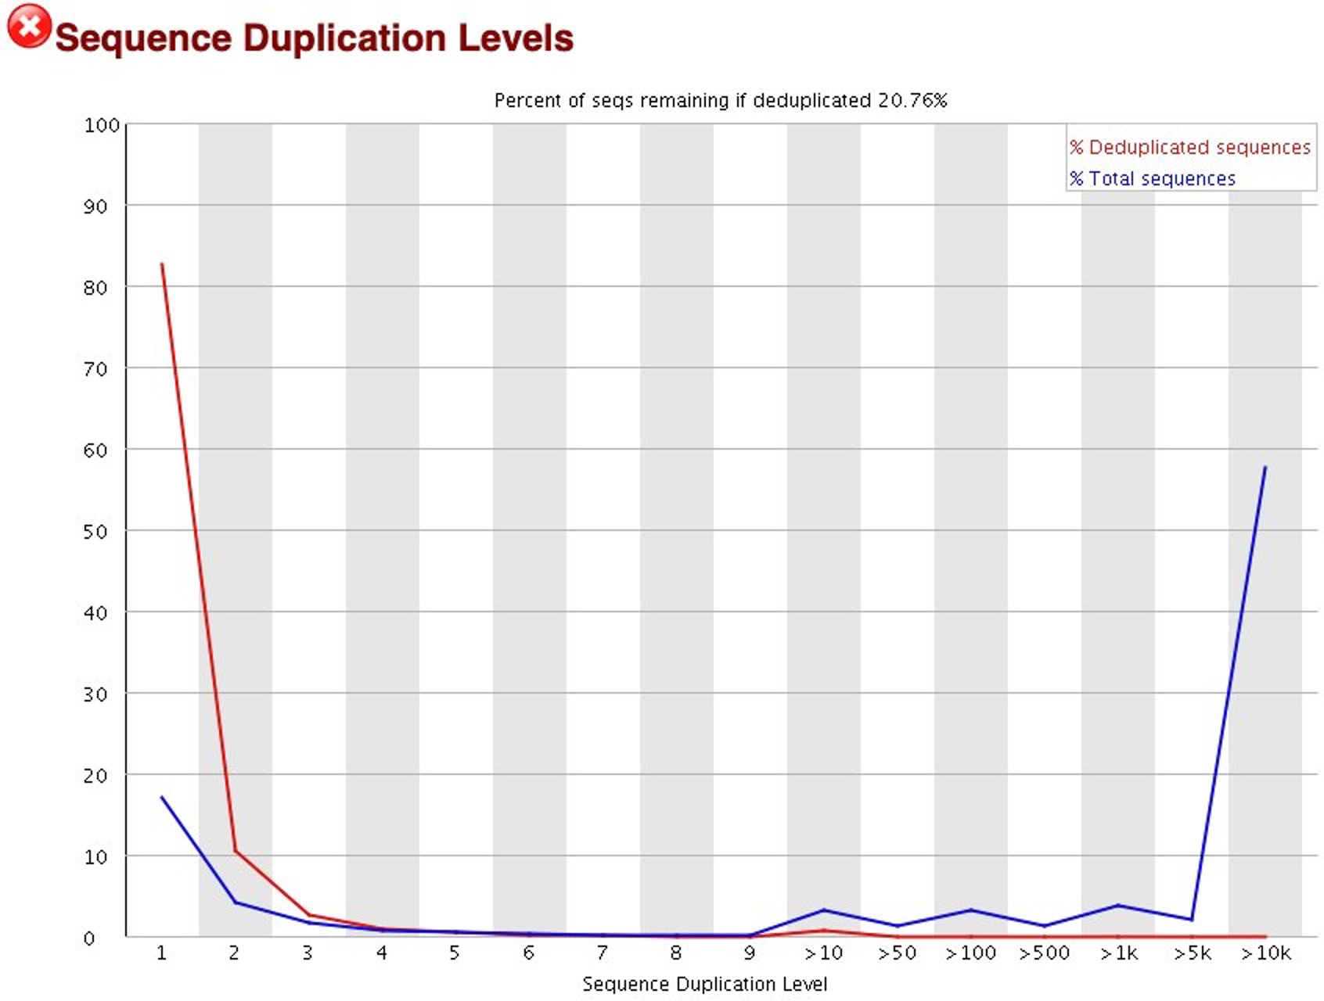
Sequence duplication levels indicate possible enrichment bias
Gold standard
10x Genomics scRNA-seq
Salvageable?
Patient sample snRNA-seq
Fail
Organoid sample snRNA-seq
Notes:
Technical duplicates arising from PCR artefacts, or biological duplicates which are natural collisions where different copies of exactly the same sequence are randomly selected
The plot shows the proportion of the library which is made up of sequences in each of the different duplication level bins
There are two lines on the plot
The blue line takes the full sequence set and shows how its duplication levels are distributed
In the red plot the sequences are de-duplicated and the proportions shown are the proportions of the deduplicated set which come from different duplication levels in the original data

Slide 12

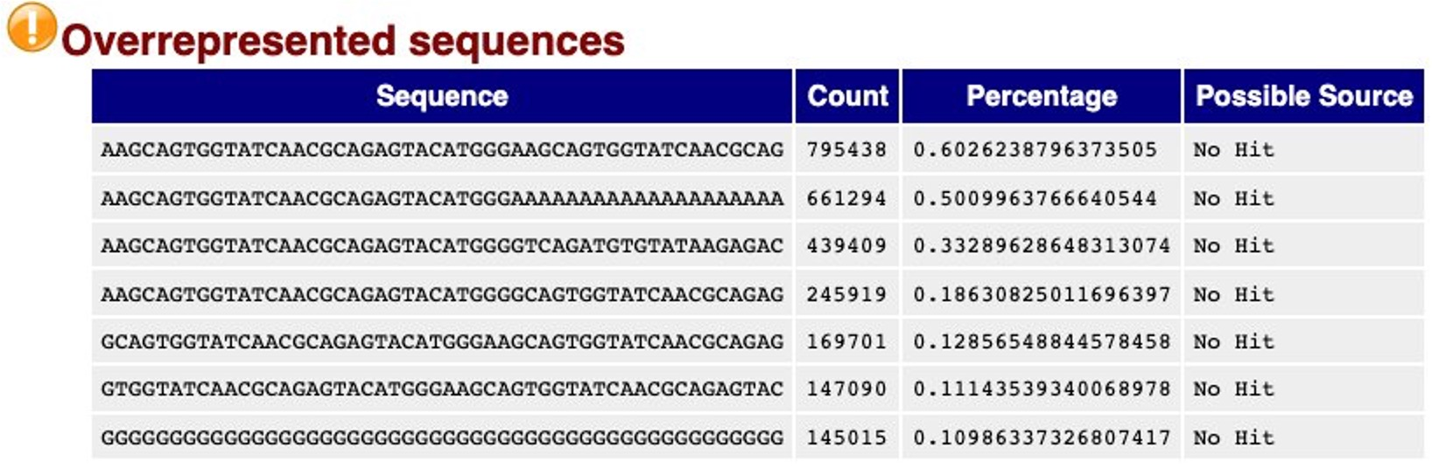
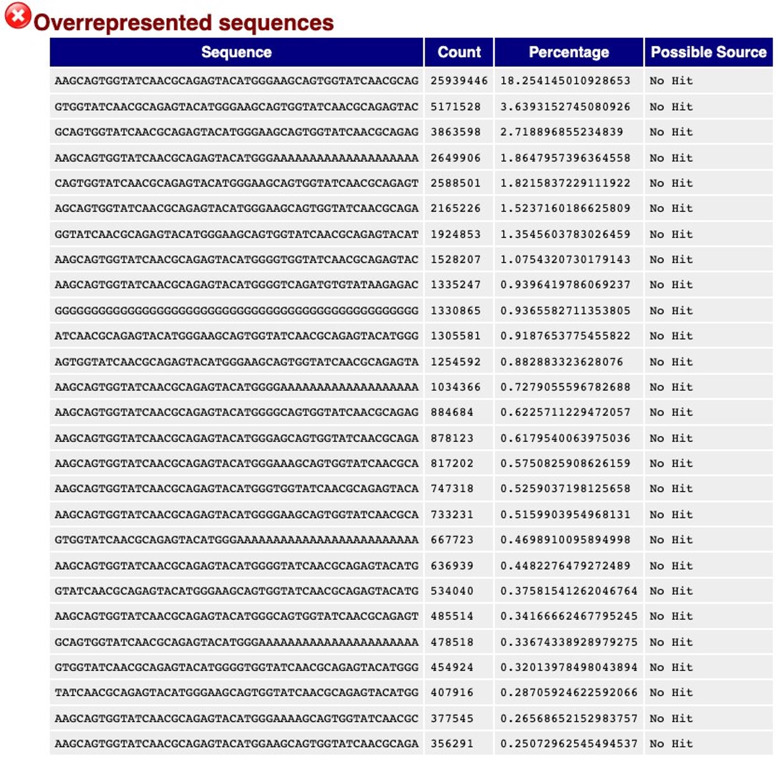
Overrepresented sequences provides a list of sequences that appear more often than expected
Gold standard
10x Genomics scRNA-seq
Salvageable?
Patient sample snRNA-seq
Fail
Organoid sample snRNA-seq
7 overrepresented sequences, ~2% of total sequences
60 overrepresented sequences, ~47% of total sequences
Notes:
Finding that a single sequence is very overrepresented in the set either means that it is highly biologically significant, or indicates that the library is contaminated, or not as diverse as you expected.
For RNA-seq may see some transcripts that are so abundant, they register as overrepresented

Slide 13
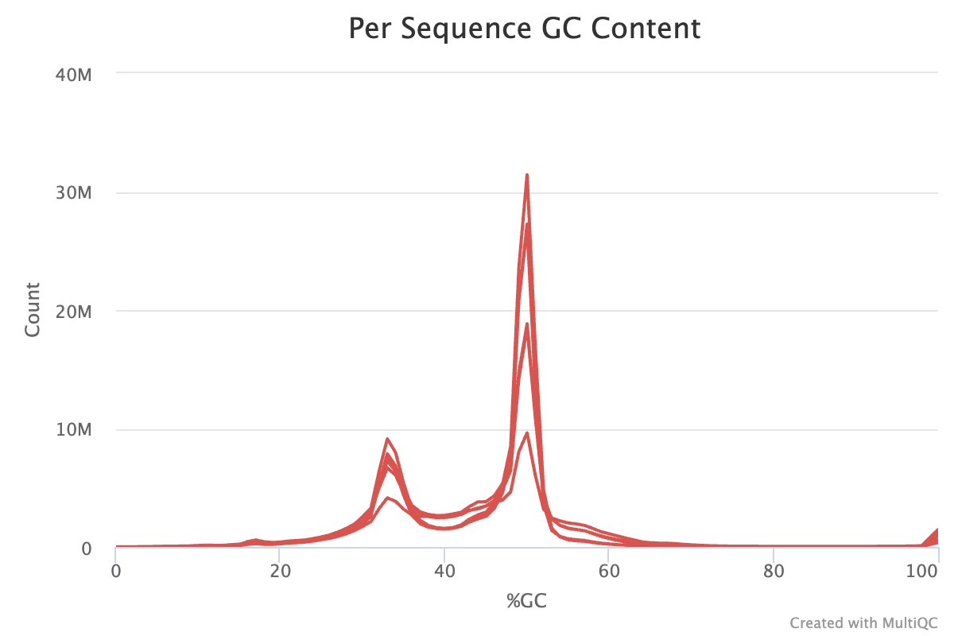
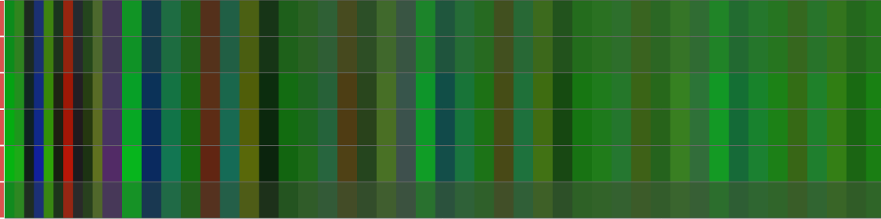
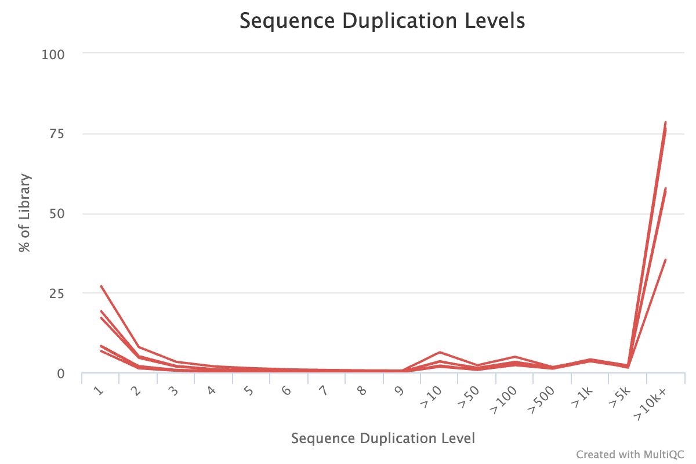
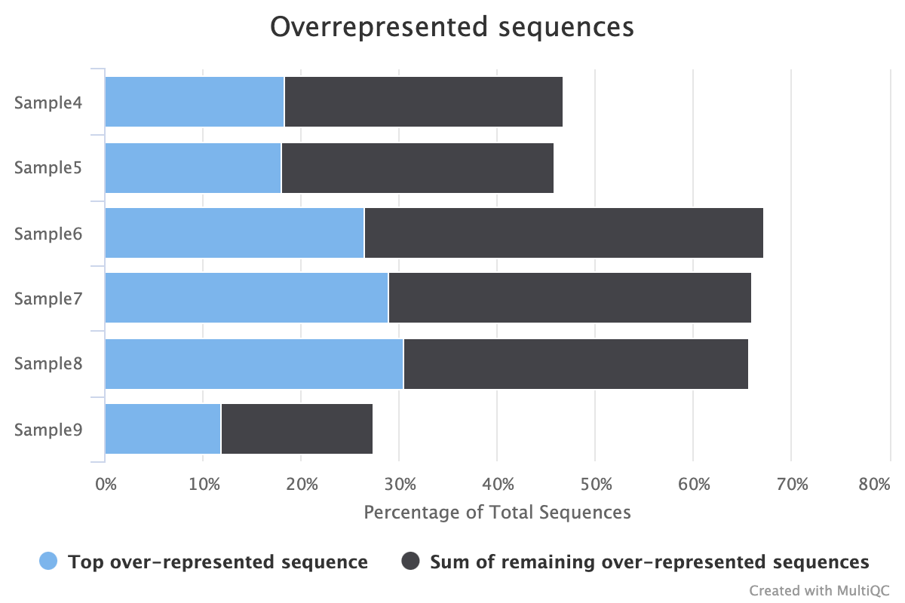
These are examples of good sequencing of bad or heavily degraded samples
Per Base Sequence Content
Notes:
Some of the expected observations you may see with adapter dimer contamination include:
Drop in per base sequence quality after base 60
Distinct patterns observed in per bases sequence content up to base 60
Sharp peaks in per sequence GC content
Highly overrepresented sequences matching adapter sequences
You may also see a bi-modal distribution of per sequence quality scores
And adapter content > 0% starting at the first base in reads
Although we don’t see these in this dataset, likely because scRNA-seq adapters aren’t found in FastQCs contamination database and because the quality of the reads was poor, but the sequencing was high quality
Hartwell: “From a sequencing point-of-view, both runs performed at or above spec.”
https://rtsf.natsci.msu.edu/genomics/tech-notes/fastqc-tutorial-and-faq/

Slide 14
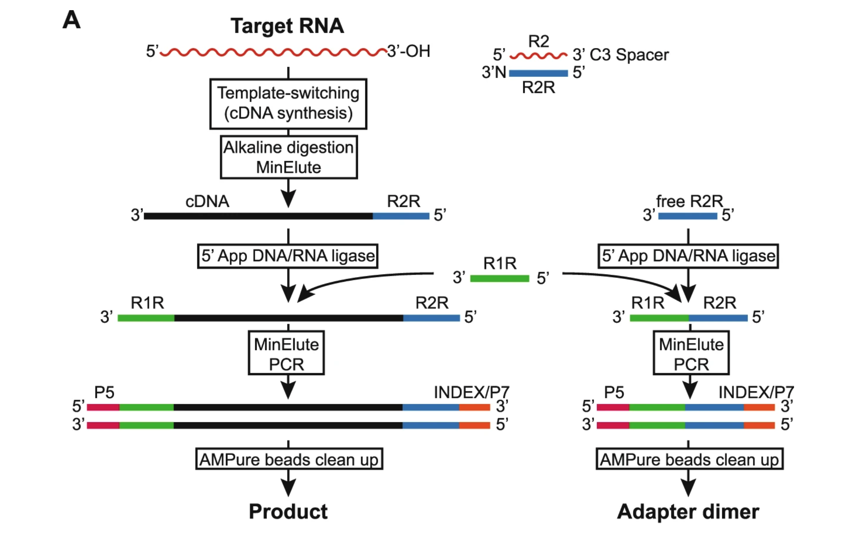
Adapter dimers can pass early QC steps when dimerization produces long sequences
30bp adapters (90 bases total)
Xu, H., Yao, J., Wu, D.C. et al. DOI: 10.1038/s41598-019-44457-z
Notes:
https://www.nature.com/articles/s41598-019-44457-z

Slide 15
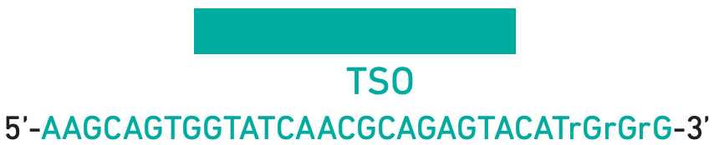
Overrepresented sequences show repetition of template switching oligo (TSO) sequence
Sequence
AAGCAGTGGTATCAACGCAGAGTACATGGGAAGCAGTGGTATCAACGCAG
AGCAGTGGTATCAACGCAGAGTACATGGGAAGCAGTGGTATCAACGCAGA
GCAGTGGTATCAACGCAGAGTACATGGGAAGCAGTGGTATCAACGCAGAG
GTGGTATCAACGCAGAGTACATGGGAAGCAGTGGTATCAACGCAGAGTAC
CAGTGGTATCAACGCAGAGTACATGGGAAGCAGTGGTATCAACGCAGAGT
AAGCAGTGGTATCAACGCAGAGTACATGGGAAAAAAAAAAAAAAAAAAAA
AAGCAGTGGTATCAACGCAGAGTACATGGGGTGGTATCAACGCAGAGTAC
Notes:
https://assets.ctfassets.net/an68im79xiti/1eX2FPdpeCgnCJtw4fj9Hx/7cb84edaa9eca04b607f9193162994de/CG000204_ChromiumNextGEMSingleCell3_v3.1_Rev_D.pdf

Slide 16
Quality control of sequencing alignment with CellRanger

Slide 17
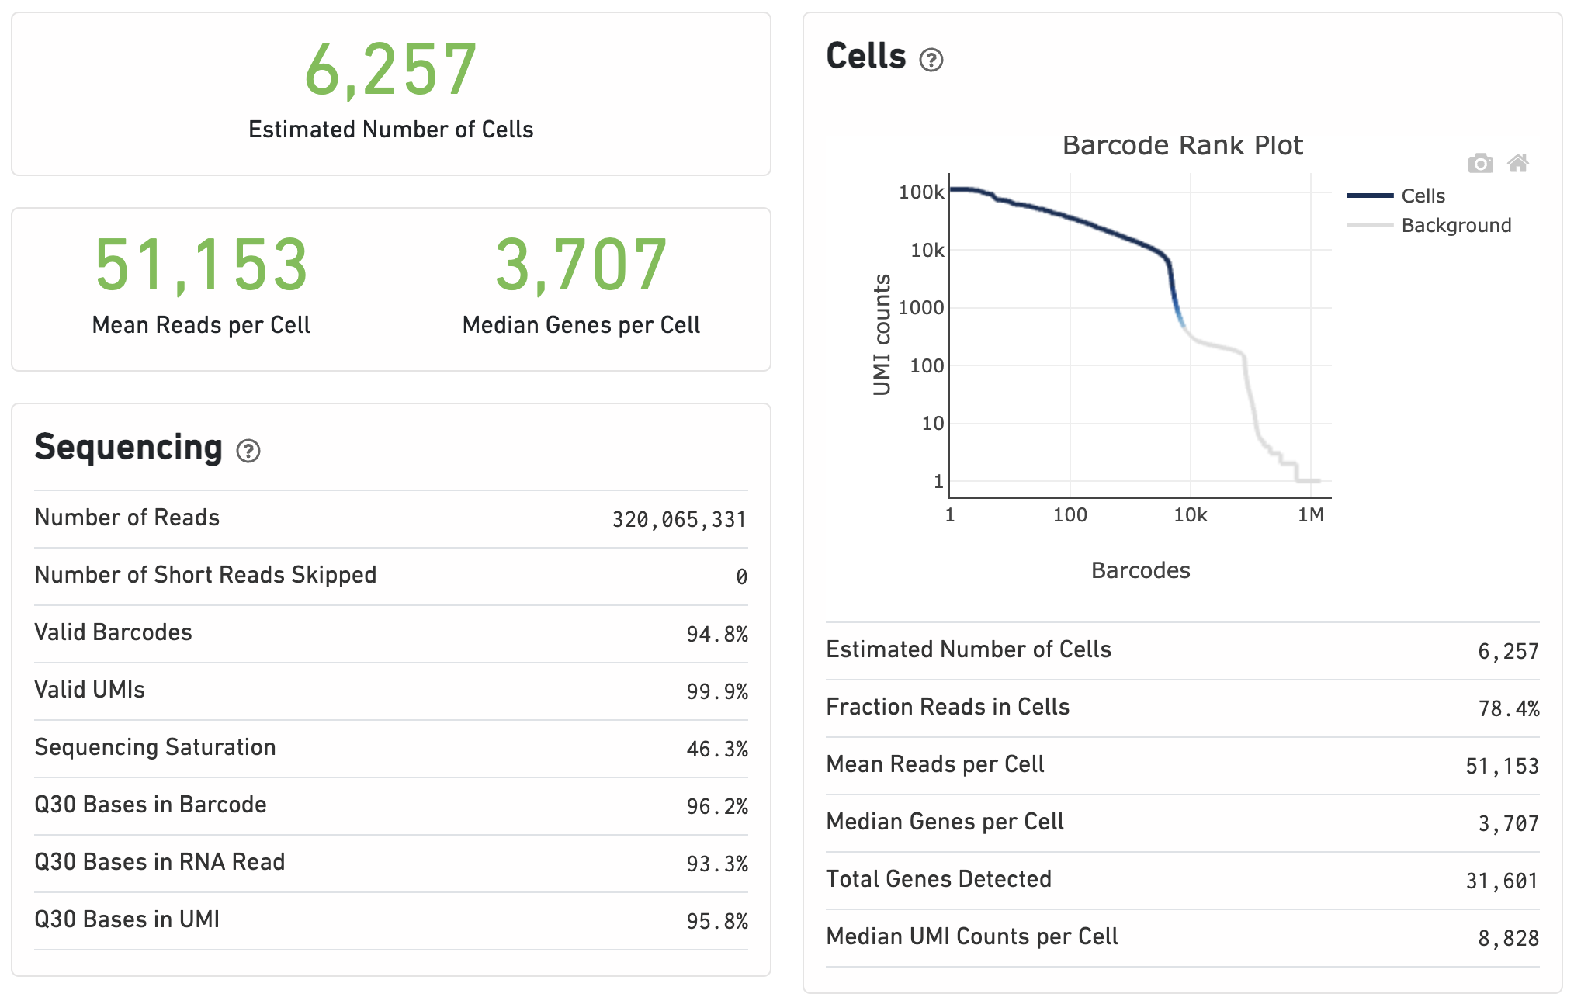
> 75%
500 – 10,000
> 75%
> 70%
depends on sequence depth
and sample complexity
> 20,000
> 85%
> 1,000
> 85%
depends on sequence depth
and sample complexity
> 85%
depends on sequence depth
and sample complexity
Notes:
https://cdn.10xgenomics.com/image/upload/v1660261286/support-documents/CG000329_TechnicalNote_InterpretingCellRangerWebSummaryFiles_RevA.pdf
A steep drop-off is indicative of good separation between the cell-associated barcodes and the barcodes associated with empty GEMs. An ideal Barcode Rank plot has a distinctive shape, which is referred to as a “cliff and knee”. The blue-to-gray transition (green arrow) is referred to as the cliff; the solid gray is referred to as the knee (blue arrow).

Slide 18
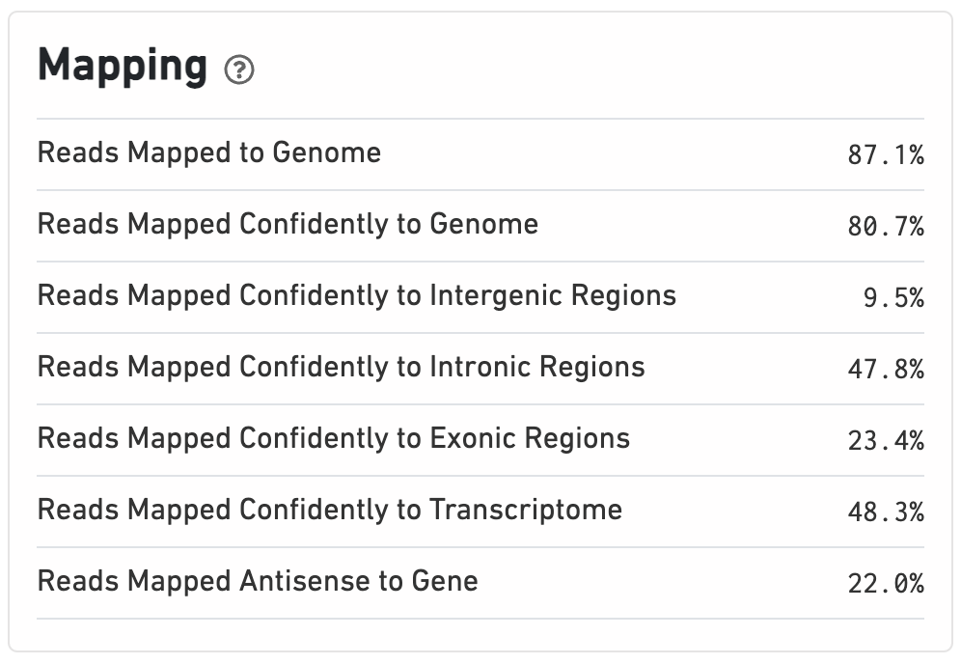
> 85%
> 80%
< 10%
< 30%
> 30%, ~60%
> 30%, ~60%
< 10%
Notes:
Typical ranges for PolyA selected libraries:
Exonic reads: 60-90%
Intronic reads: Up to 30%
Intergenic reads: <10%
Typical ranges for total RNA libraries:
Exonic reads: 35-70%
Intronic reads: Up to 60%
Intergenic reads: <10%

Slide 19
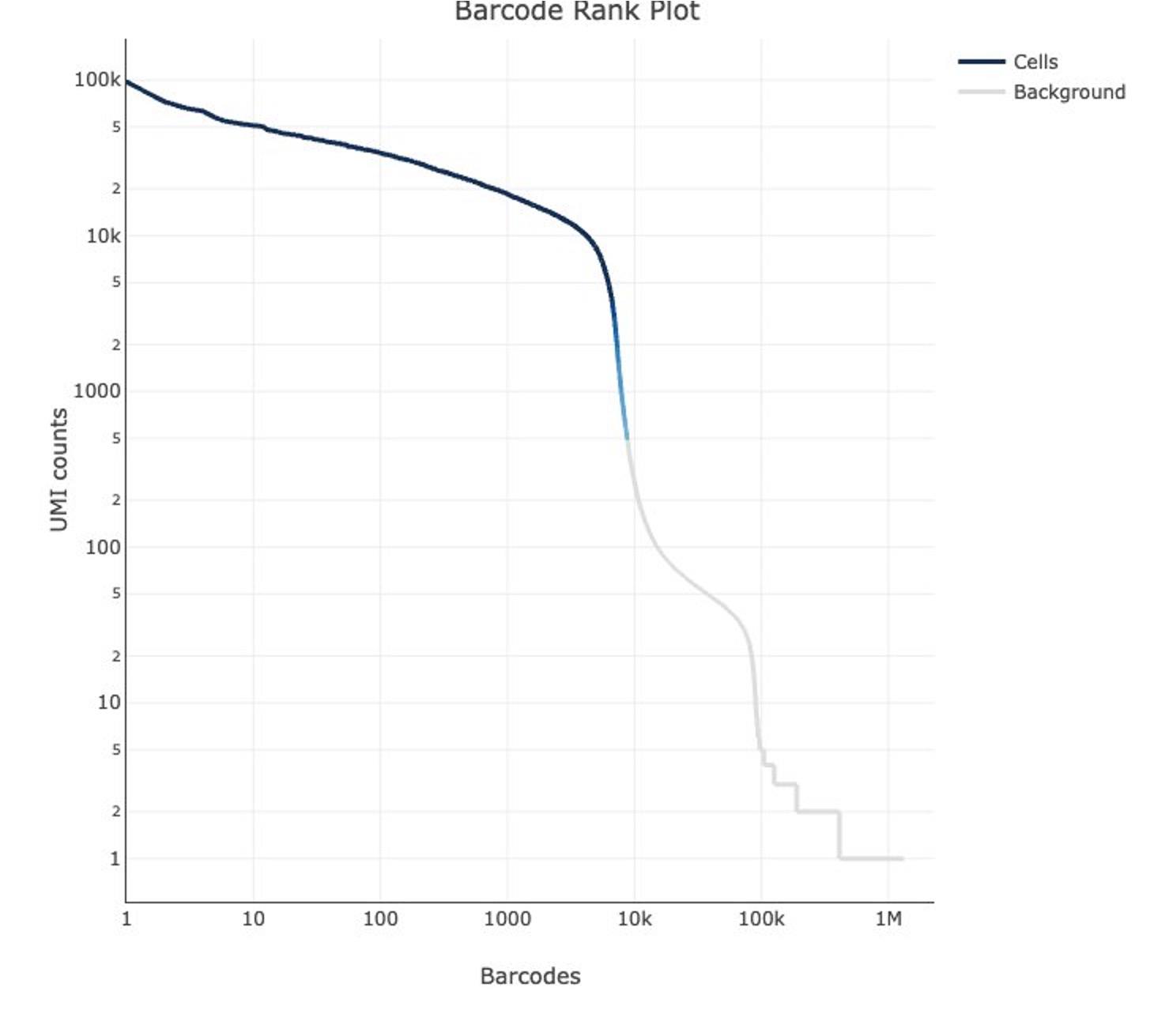
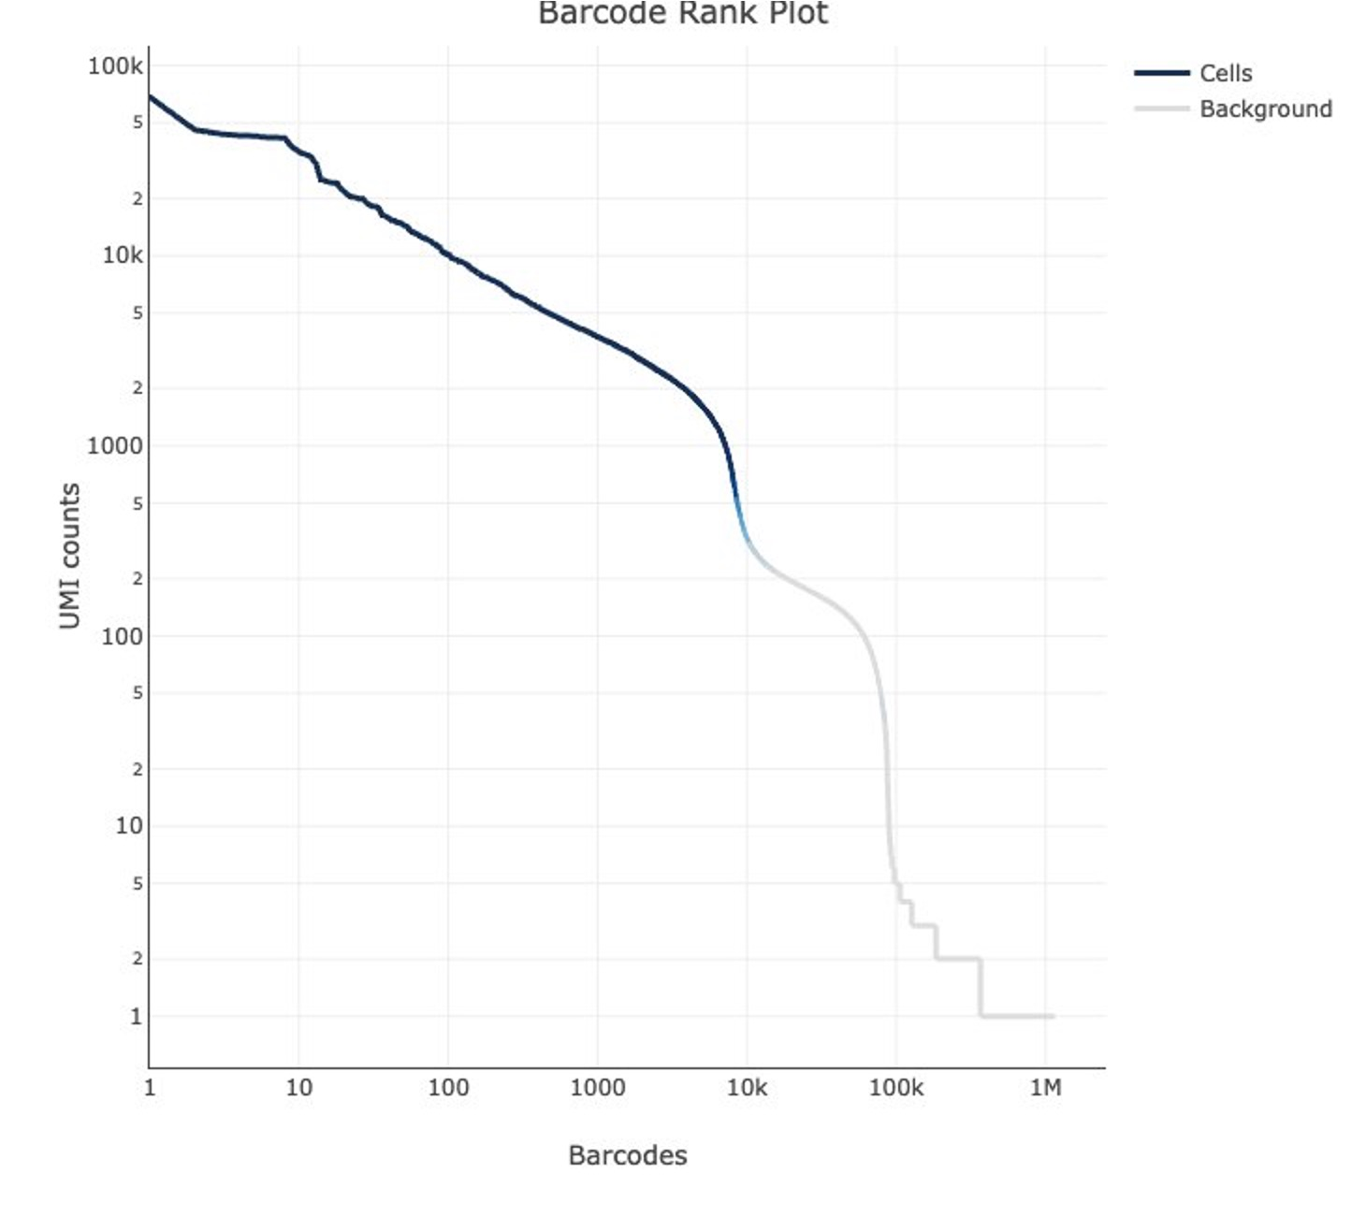
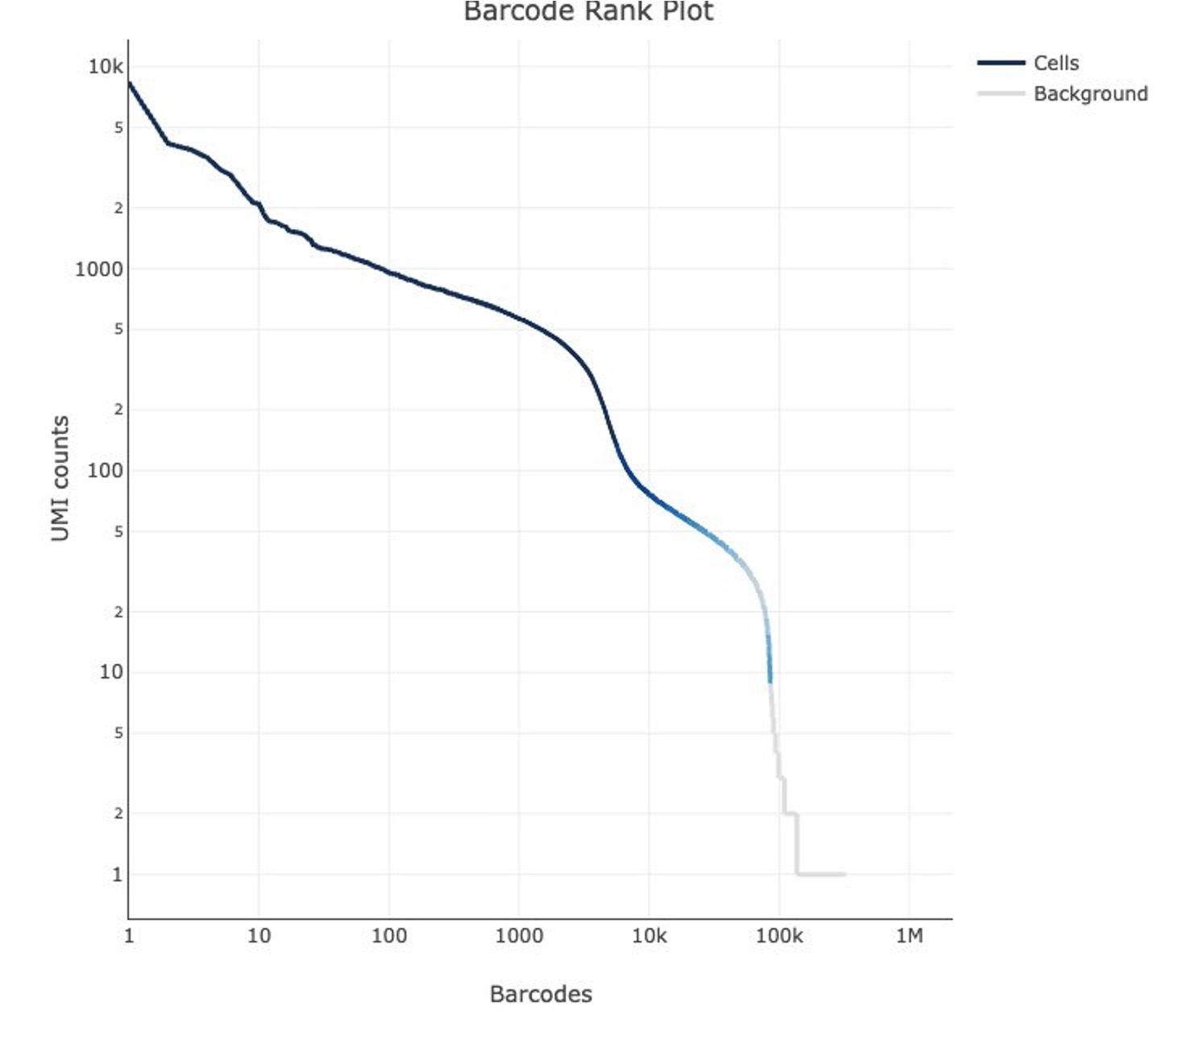
​ | Good Sample
Number of Reads​ | 293,132,076​
Q30 Bases in RNA Read​ | 94.90%​
Mapped to Genome​ | 92.70%​
Mapped Confidently to Genome​ | 89.30%​
Mapped Confidently to Exonic Regions​ | 50.90%​
Mapped Confidently to Transcriptome​ | 47.50%​
Number of Cells after Filtering​ | 6,510​
Sample with Concerns
209,364,338​
90.30%​
59.70%​
53.30%​
15.30%​
19.80%​
6,841​
Outlier Sample
316,003,364​
87.60%​
9.00%​
6.40%​
1.40%​
2.20%​
2,217​

Slide 20
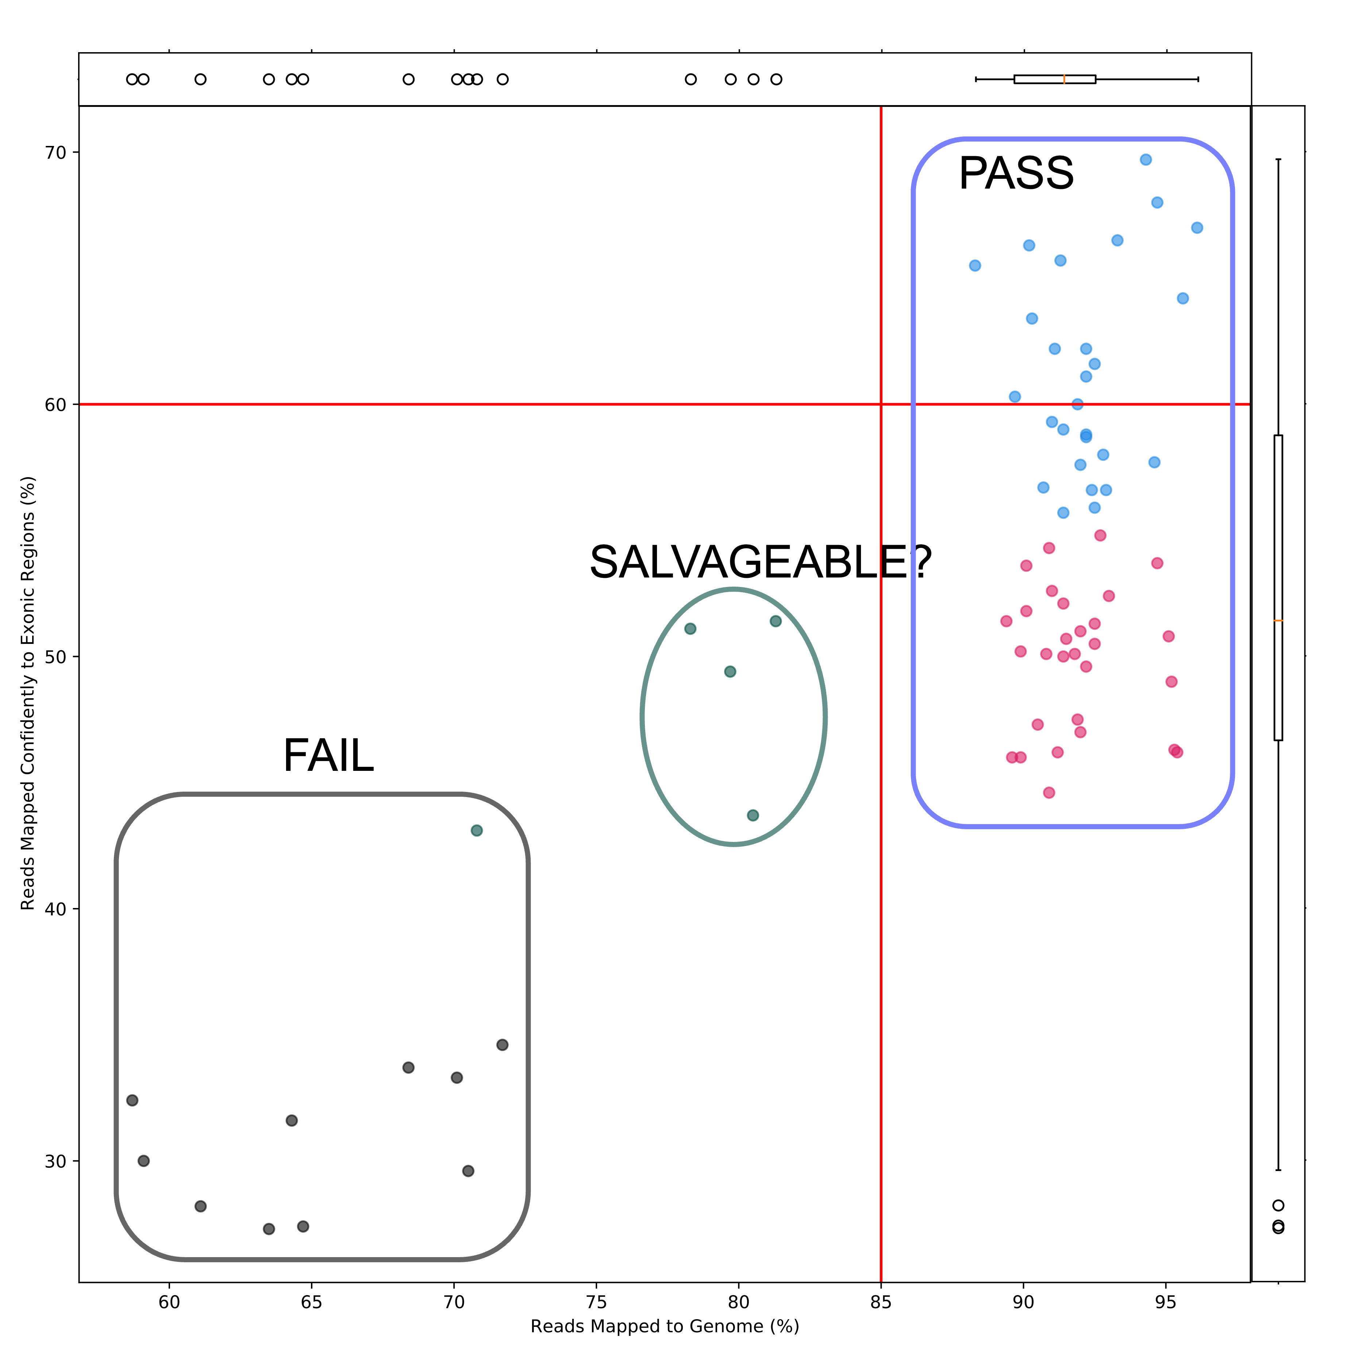
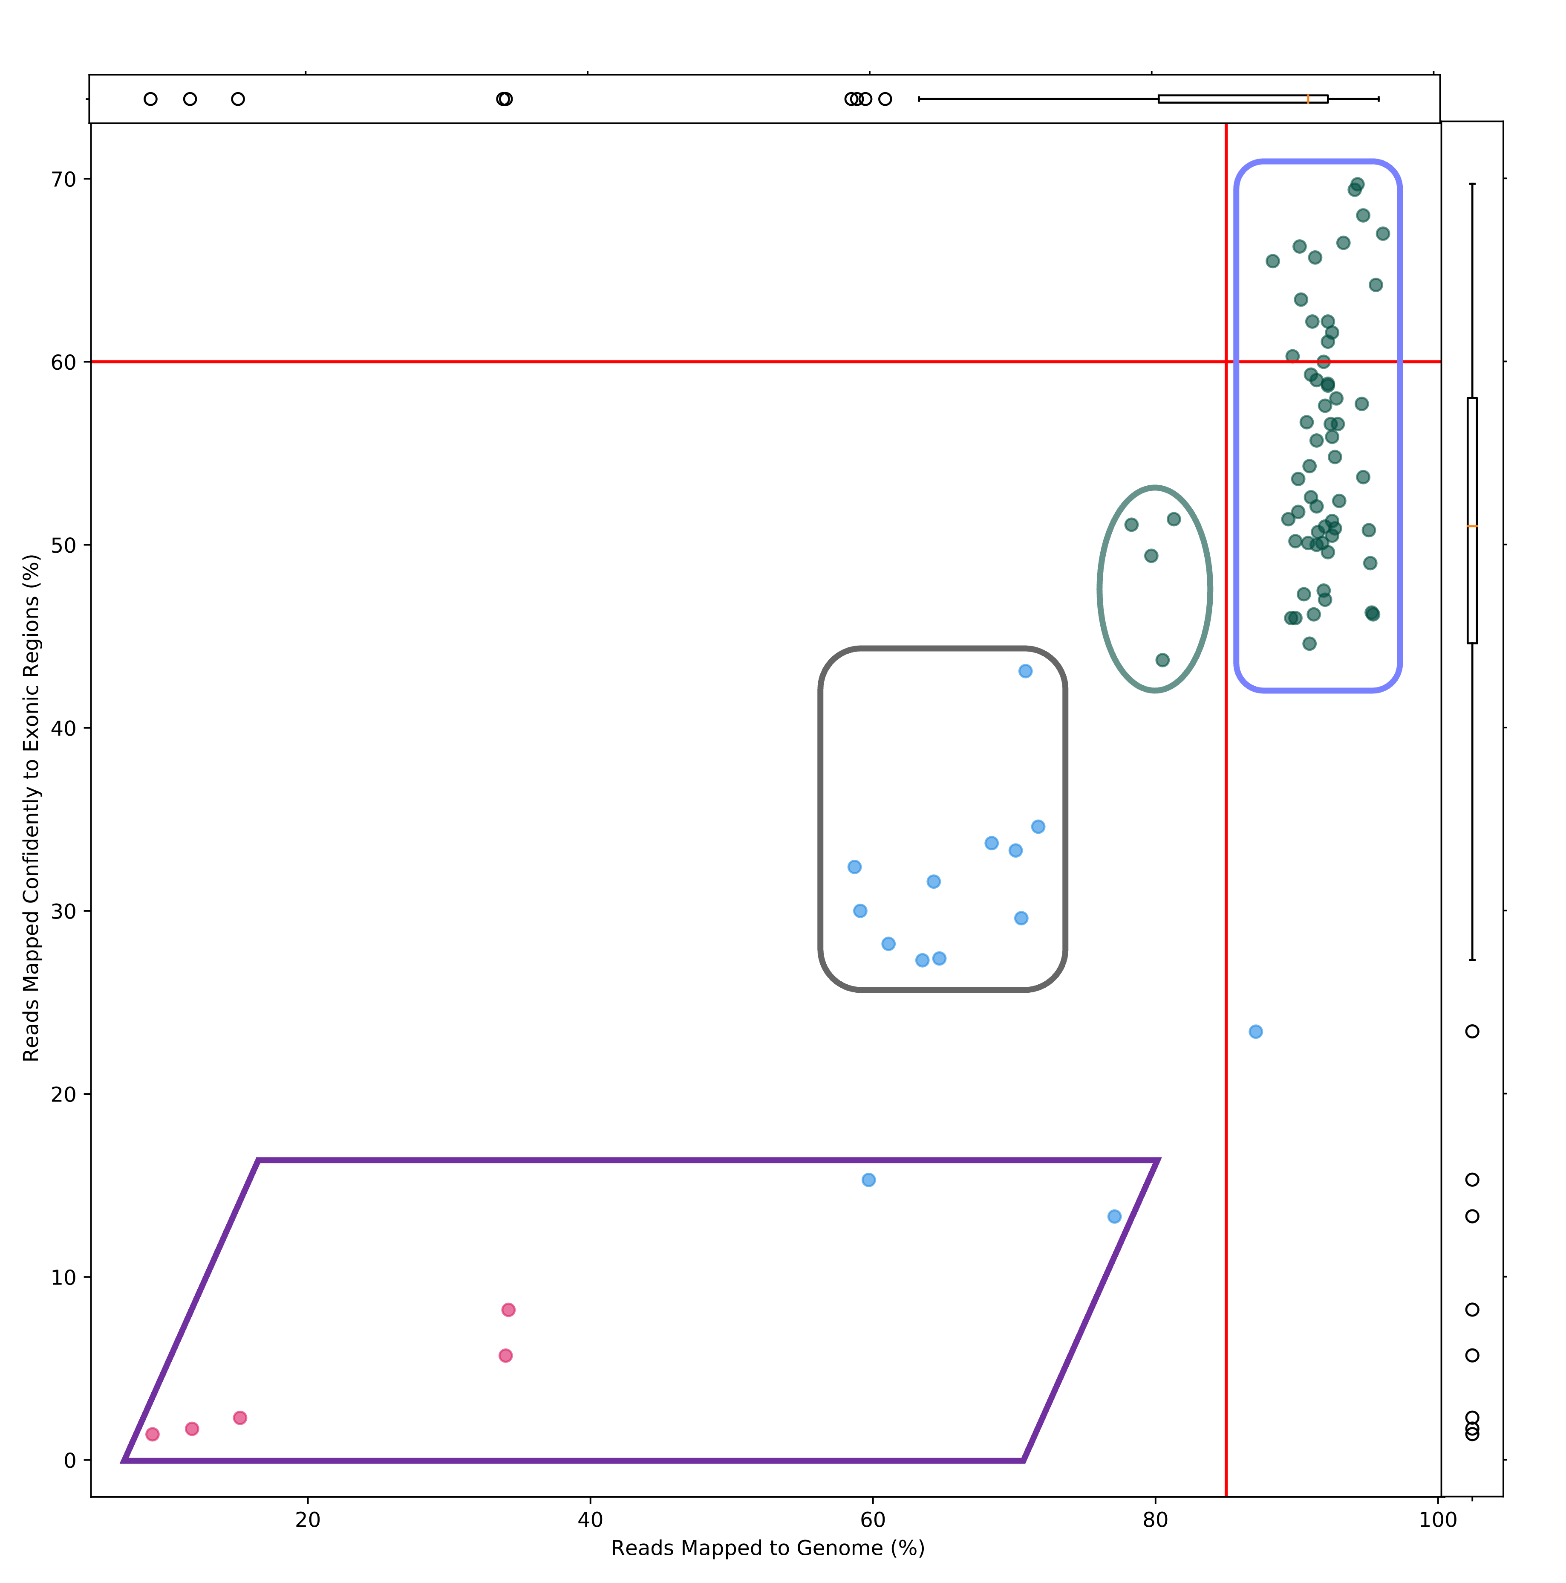
Example of read mapping metrics for range of samples
Notes:
This plot was generated ad hoc, not part of CellRanger report or other QC tools
Can be generated by Bioinformatics Core for reporting, if needed

Slide 21
Filtering low quality cells with Seurat

Slide 22
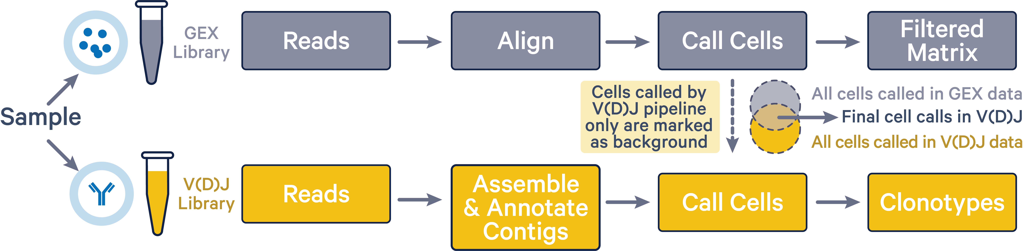
Count matrix (aka gene-barcode matrix) from CellRanger is input into Seurat for cell-level filtering
Kim N, Kang H, Jo A, Yoo SA, Lee HO. DOI: 10.4132/jptm.2022.12.19
Notes:
Major output of CellRanger is UMI counts for barcodes determined to be true barcodes
Filtering, most downstream analysis is based on using the gene-barcode matrix as input

Slide 23
Baseline values for cell-level filtering we use (may change based on each specific experiment)
Technology | Cut-offs | Filter 1 | Filter 1 |  |  | Filter 2 (Outliers, Optional)
 |  | Cells per gene | nFeature_RNA (genes detected) | nCount_RNA (UMIs detected) | Percent Mitochondrial | nFeature_RNA (genes detected) | Percent Mitochondrial
scRNA | Min | 10 | 300 | 500 | - | -3*MAD | -
 | Max | - | - | - | 15, ideally 10 | +3*MAD | +3*MAD
snRNA | Min | 10 | 300 | 500 | - | -3*MAD | -
 | Max | - | - | - | 5, ideally 1 | +3*MAD | +3*MAD
Notes:
These are baseline values Bioinformatics Core uses for running filtering
Generally, do not like to go lower/higher than these levels
But it can depend on the specific project, cell types, experiment, project goals, etc.
Tutorial for filtering guidance:
https://hbctraining.github.io/scRNA-seq_online/lessons/04_SC_quality_control.html

Slide 24
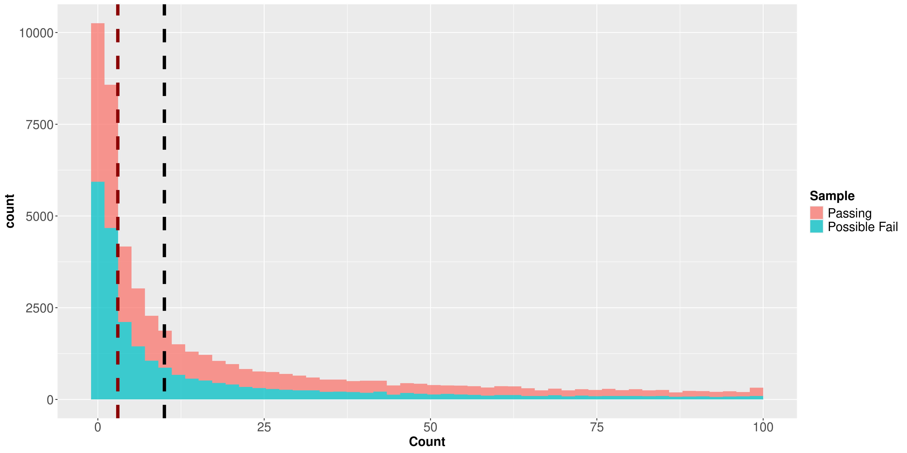
Cells per gene threshold can be used to remove lowly detected genes
Cells = 3
Cells = 10
Notes:
Genes detected in at least 3 cells is Seurat default when loading a gene-barcode matrix to make a Seurat object
May be cases where you keep all genes except those expressed in no cells at all
In the example below from (Wang, et al. (2016) study on the human endocrine pancreas transcriptome, some cell types exist as very small clusters (e.g acinar cell – 6-cell cluster, δ-cell – 9-cell cluster). A threshold of 5 cells per gene may remove several specific marker genes in such tiny clusters (Figure 1). In such cases, the minimum cells per gene threshold is not necessary.

Slide 25
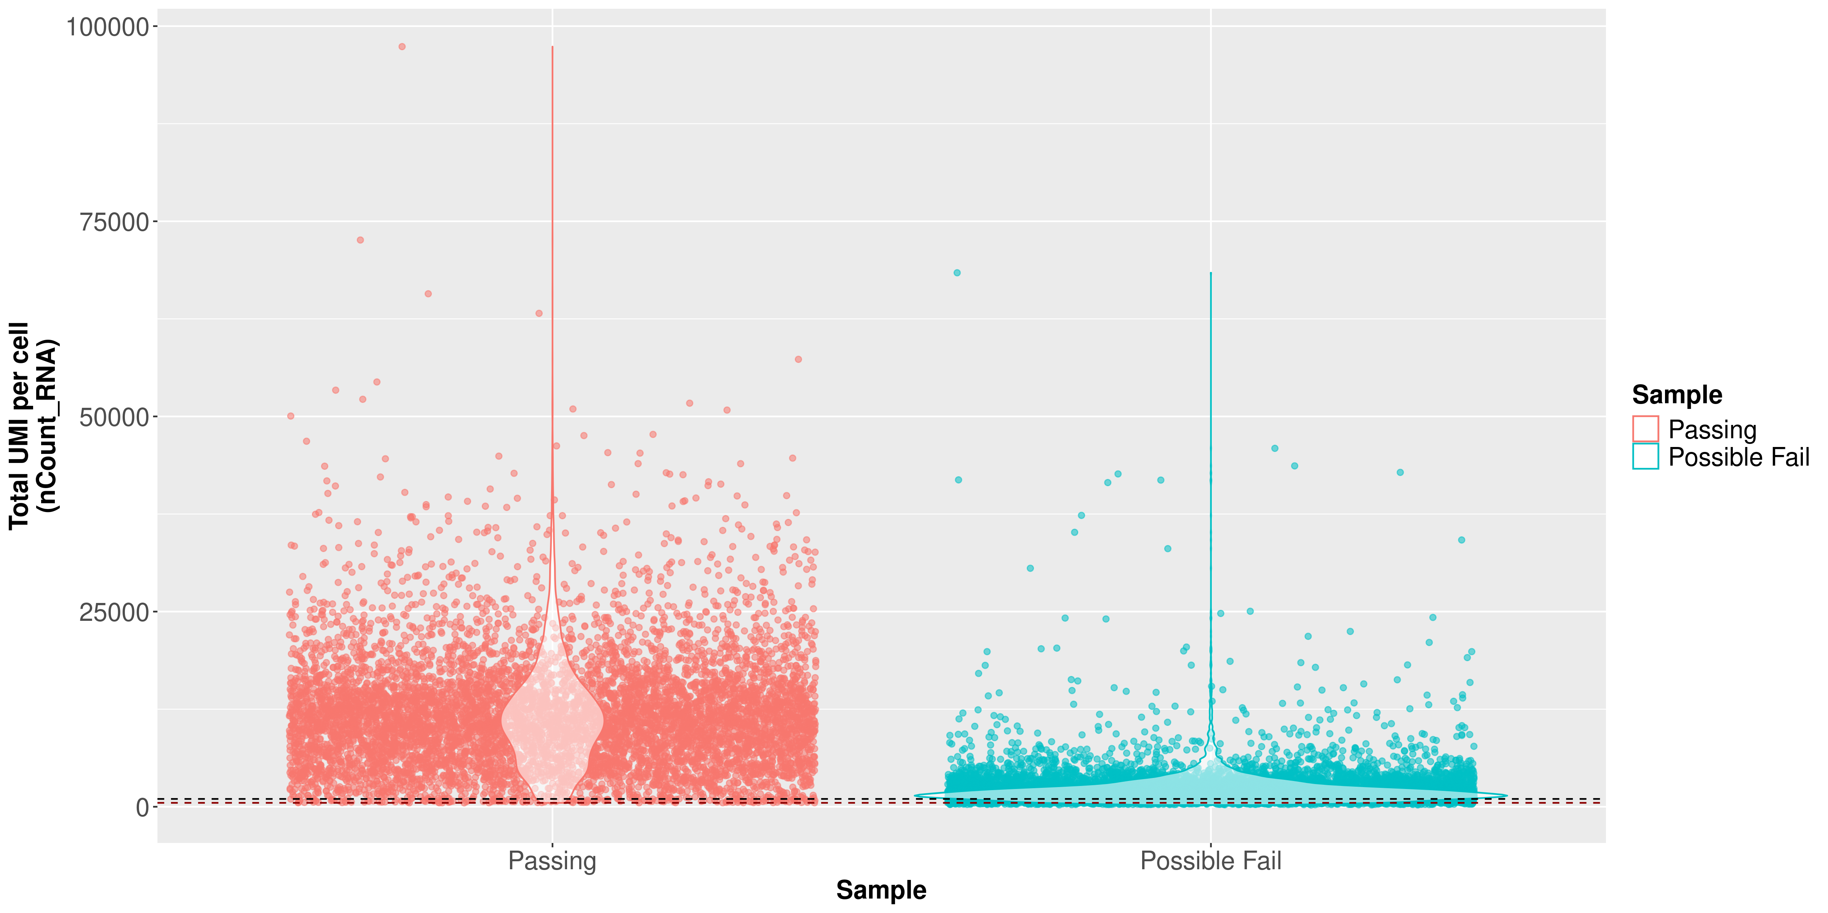
UMI counts (transcripts) per cell can be used to filter out “empty” cells or poorly sequenced cells
Notes:
Cells with 500 UMI likely were not sequenced very deeply, which is why we prefer higher UMI (at least 1000), but these cells are still likely usable
https://www.10xgenomics.com/analysis-guides/common-considerations-for-quality-control-filters-for-single-cell-rna-seq-data
The UMI counts per cell should generally be above 500, that is the low end of what we expect. If UMI counts are between 500-1000 counts, it is usable but the cells probably should have been sequenced more deeply.
The total UMI counts associated with a cell barcode represent the absolute number of observed transcripts in the droplet. Barcodes associated with unusually high UMI counts might be multiplets (i.e. one droplet containing multiple cells), whereas barcodes with low UMI counts might be droplets containing ambient RNAs but not real cells. Therefore, using UMI counts to filter cell barcodes may help to eliminate barcodes that do not represent a single cell. The choice of UMI count thresholds in published literature can vary between arbitrary cutoffs or the use of data-driven threshold, e.g. three to five times of standard deviation or median absolute deviation from the median (You et al., 2021, Ocasio et al., 2019).

Slide 26
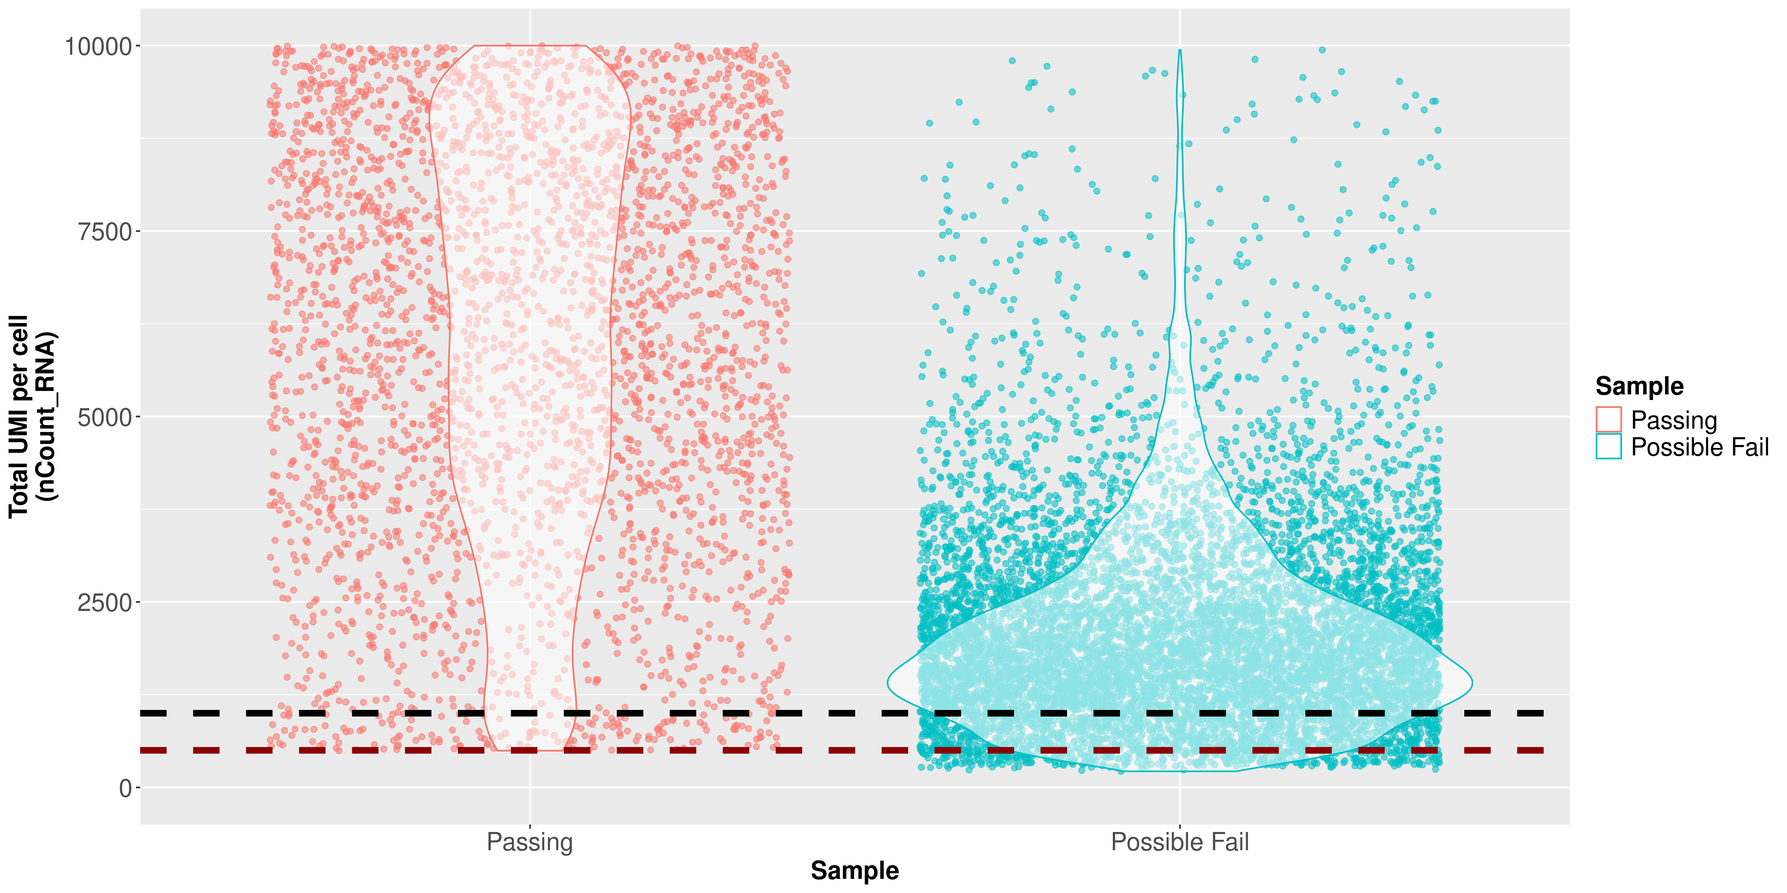
UMI counts (transcripts) per cell can be used to filter out “empty” cells or poorly sequenced cells
UMI = 1000
UMI = 500
Notes:
Cells with 500 UMI likely were not sequenced very deeply, which is why we prefer higher UMI (at least 1000), but these cells are still likely usable
https://www.10xgenomics.com/analysis-guides/common-considerations-for-quality-control-filters-for-single-cell-rna-seq-data
The UMI counts per cell should generally be above 500, that is the low end of what we expect. If UMI counts are between 500-1000 counts, it is usable but the cells probably should have been sequenced more deeply.
The total UMI counts associated with a cell barcode represent the absolute number of observed transcripts in the droplet. Barcodes associated with unusually high UMI counts might be multiplets (i.e. one droplet containing multiple cells), whereas barcodes with low UMI counts might be droplets containing ambient RNAs but not real cells. Therefore, using UMI counts to filter cell barcodes may help to eliminate barcodes that do not represent a single cell. The choice of UMI count thresholds in published literature can vary between arbitrary cutoffs or the use of data-driven threshold, e.g. three to five times of standard deviation or median absolute deviation from the median (You et al., 2021, Ocasio et al., 2019).

Slide 27
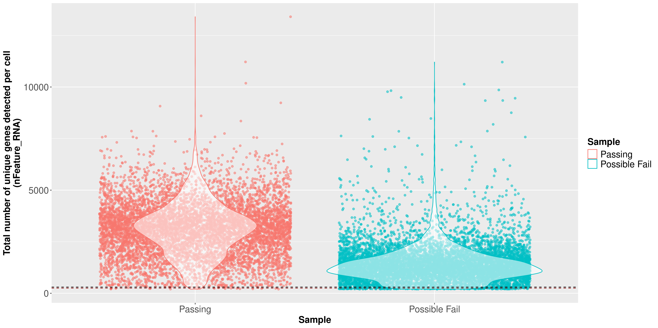
Genes (features) detected per cell can be dependent on cell type
Notes:
It could also be that there are biologically different types of cells (i.e. quiescent cell populations, less complex cells of interest), and/or one type is much smaller than the other (i.e. cells with high counts may be cells that are larger in size). Therefore, this threshold should be assessed with other metrics that we describe in this lesson.
Minimum threshold of gene per cells tries to ensure that you are capturing the transcriptional diversity of your cells

Slide 28
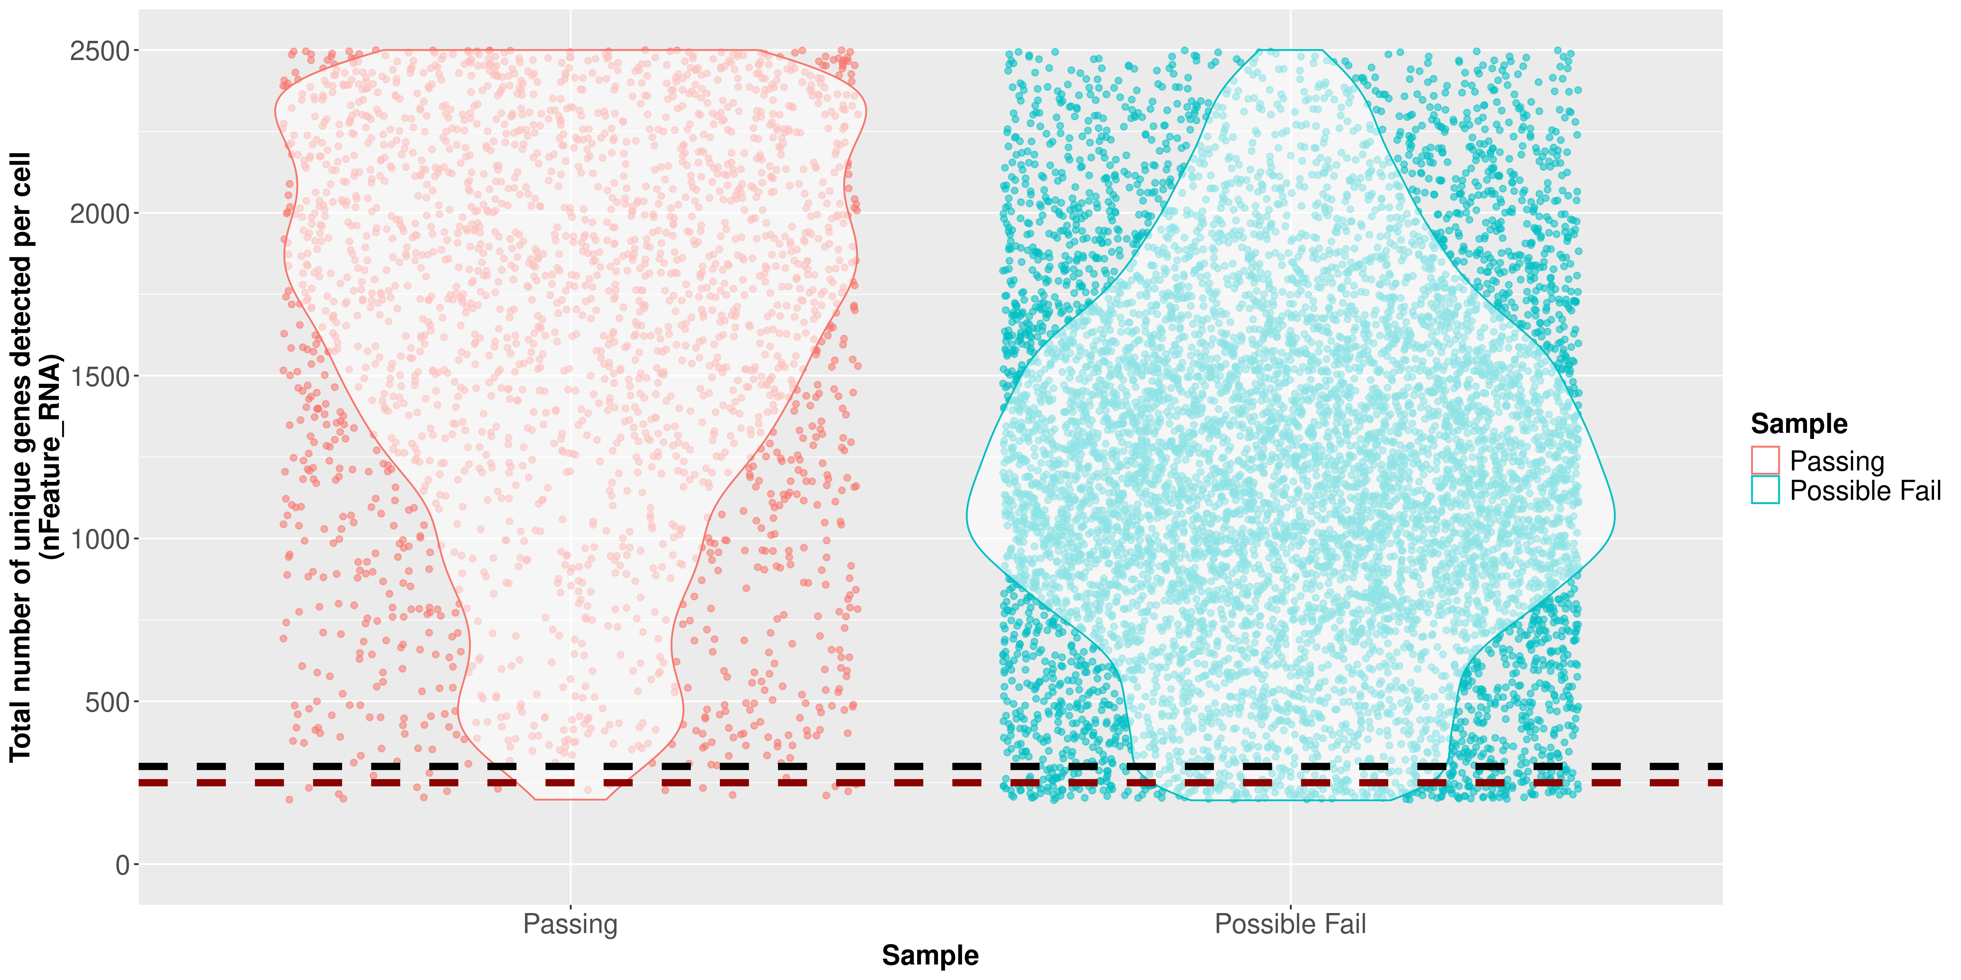
Genes (features) detected per cell can be dependent on cell type
Genes = 300
Genes = 250
Notes:
It could also be that there are biologically different types of cells (i.e. quiescent cell populations, less complex cells of interest), and/or one type is much smaller than the other (i.e. cells with high counts may be cells that are larger in size). Therefore, this threshold should be assessed with other metrics that we describe in this lesson.
Minimum threshold of gene per cells tries to ensure that you are capturing the transcriptional diversity of your cells

Slide 29
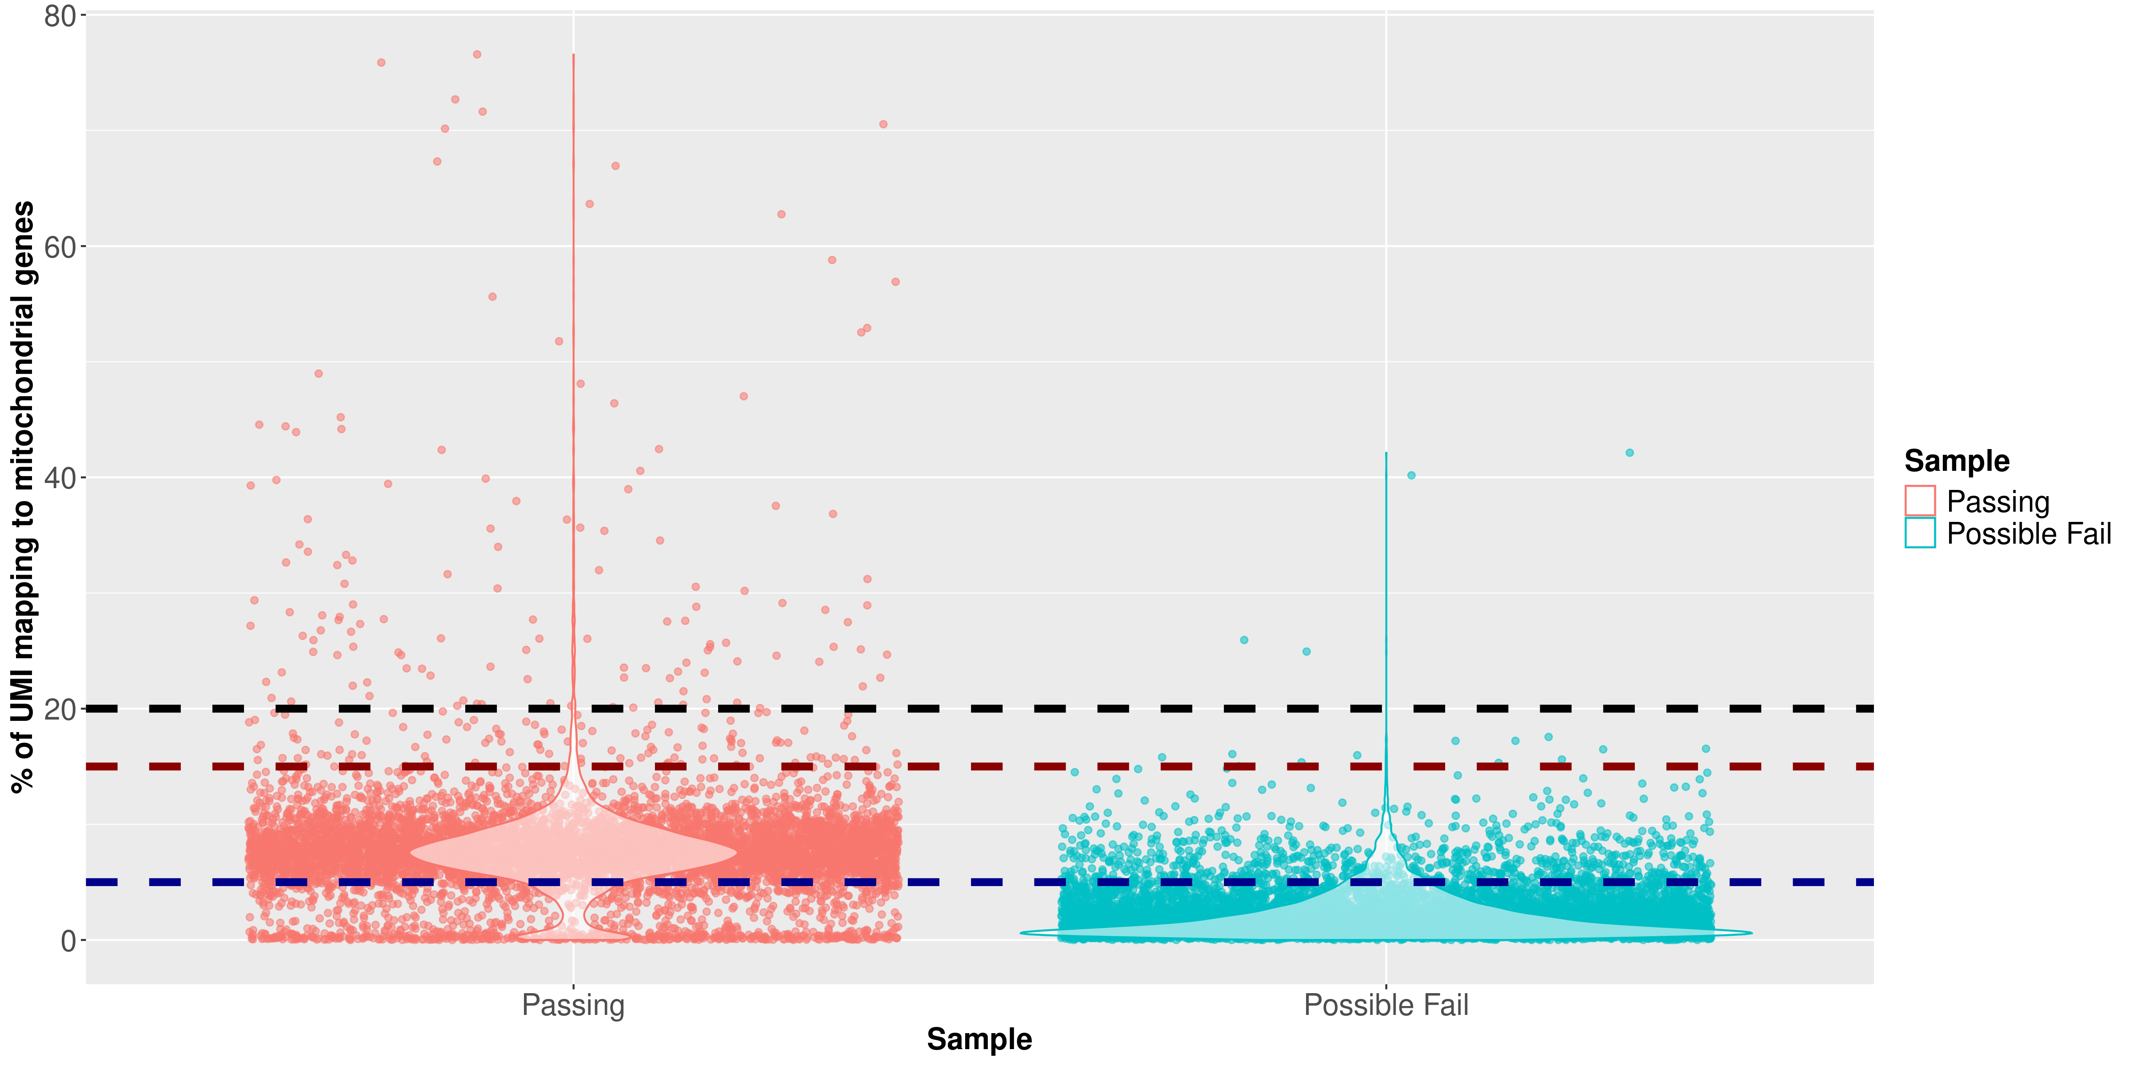
Mitochondrial percentage parameter can be dependent on the sample type, cell type
MT% = 20%
MT% = 15%
MT% = 5%
Notes:
Mitochondrial genes are involved in several processes, such as gene regulations, cancer, aging, degenerative diseases, etc. A high mitochondrial count may indicate high respiratory activity, rather than apoptosis. Different tissues also vary in the mitochondrial count.
Mercer et al. (2011) observed that this number can range from 5% to 30% between tissues due to varied energy demands. Other factors can also contribute to the variation, such as species, sequencing platforms, sample conditions, etc.
Osorio & Cai (2021) found that the average proportion of mitochondrial DNA in scRNA-seq data from human tissues is significantly higher than in mouse tissue. The authors recommended a new standardized threshold for the mitochondrial count of:
10% in human samples
5% for mouse samples.

Slide 30
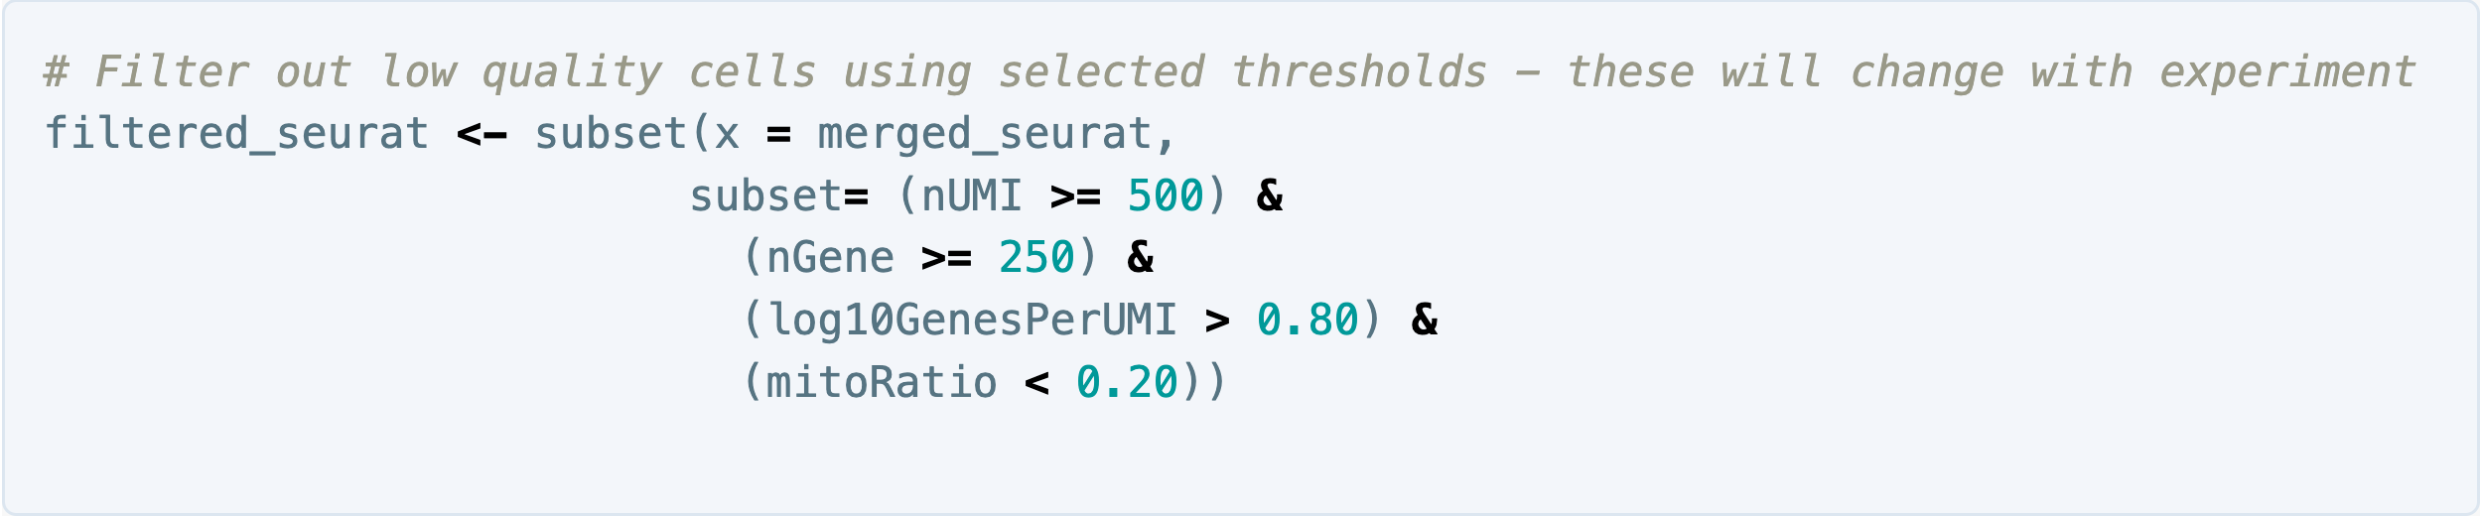
Cell-level filtering values are ultimately based on each specific experiment
Notes:
Now that we have visualized the various metrics, we can decide on the thresholds to apply which will result in the removal of low quality cells. Often the recommendations mentioned earlier are a rough guideline, and the specific experiment needs to inform the exact thresholds chosen.

Slide 31
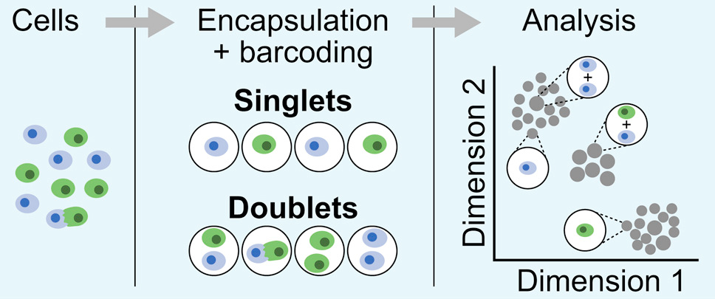
Cell-level filtering can also include doublet detection
Wolock SL, Lopez R, Klein AM.. DOI: 10.1016/j.cels.2018.11.005
Notes:
Doublets can occur when a droplet captures two or more cells instead of just one, making it appear as if the transcripts from multiple cell originate from only one cell
A couple different approaches that can be used to detected doublets, one approach is to set maximum thresholds for UMI or gene counts, to exclude cells that seem to have unusually high expression
Or use tools that attempt to characterize what doublet expression profiles would like for your specific data and identify cells with those expression patterns (e.g DoubletFinder)
Neuronal cells have lots of intermediate expression, could filter out true cells as doublets
In single-cell RNA sequencing experiments, doublets are generated from two cells. They typically arise due to errors in cell sorting or capture, especially in droplet-based protocols involving thousands of cells. Doublets are obviously undesirable when the aim is to characterize populations at the single-cell level. In particular, they can incorrectly suggest the existence of intermediate populations or transitory states that do not actually exist. Thus, it is desirable to remove doublet libraries so that they do not compromise interpretation of the results.
Many workflows use maximum thresholds for UMIs or genes, with the idea that a much higher number of reads or genes detected indicate multiple cells. While this rationale seems to be intuitive, it is not accurate. Also, many of the tools used to detect doublets tend to get rid of cells with intermediate or continuous phenotypes, although they may work well on datasets with very discrete cell types. Scrublet is a popular tool for doublet detection, but we haven’t adequately benchmarked it yet. Currently, we recommend not including any thresholds at this point in time. When we have identified markers for each of the clusters, we suggest exploring the markers to determine whether the markers apply to more than one cell type.

Slide 32
After cell-level filtering, downstream analysis typical begins with dimensionality reduction and clustering
Normalize
Scale
Kim N, Kang H, Jo A, Yoo SA, Lee HO. DOI: 10.4132/jptm.2022.12.19
Notes:
https://satijalab.org/seurat/articles/pbmc3k_tutorial
Normalization method “LogNormalize” that normalizes the feature expression measurements for each cell by the total expression, multiplies this by a scale factor (10,000 by default), and log-transforms the result
We next calculate a subset of features that exhibit high cell-to-cell variation in the dataset (i.e, they are highly expressed in some cells, and lowly expressed in others)
We apply a linear transformation (‘scaling’) that is a standard pre-processing step prior to dimensional reduction techniques like PCA
For the first principal components, Seurat outputs a list of genes with the most positive and negative loadings, representing modules of genes that exhibit either correlation (or anti-correlation) across single-cells in the dataset
Seurat clusters cells based on their PCA scores, with each PC essentially representing a ‘metafeature’ that combines information across a correlated feature set
The top principal components therefore represent a robust compression of the dataset
Based on each cell’s values for the principal components, Seurat then performs clustering to attempt to group cells with similar expression profile
Distance metric which drives the clustering analysis (based on previously identified PCs)
First construct a KNN graph based on the euclidean distance in PCA space, and refine the edge weights between any two cells based on the shared overlap in their local neighborhoods
Iteratively group cells together to find optimized groupings or clusters
Then finally to visualize the clustering in two dimensions, you can use either tSNEs or UMAPs
Cells that are grouped together within graph-based clusters determined above should generally co-localize on these dimension reduction plots

Slide 33
Additional processing steps before “finalizing” dataset for analysis (Harmony, SoupX)

Slide 34
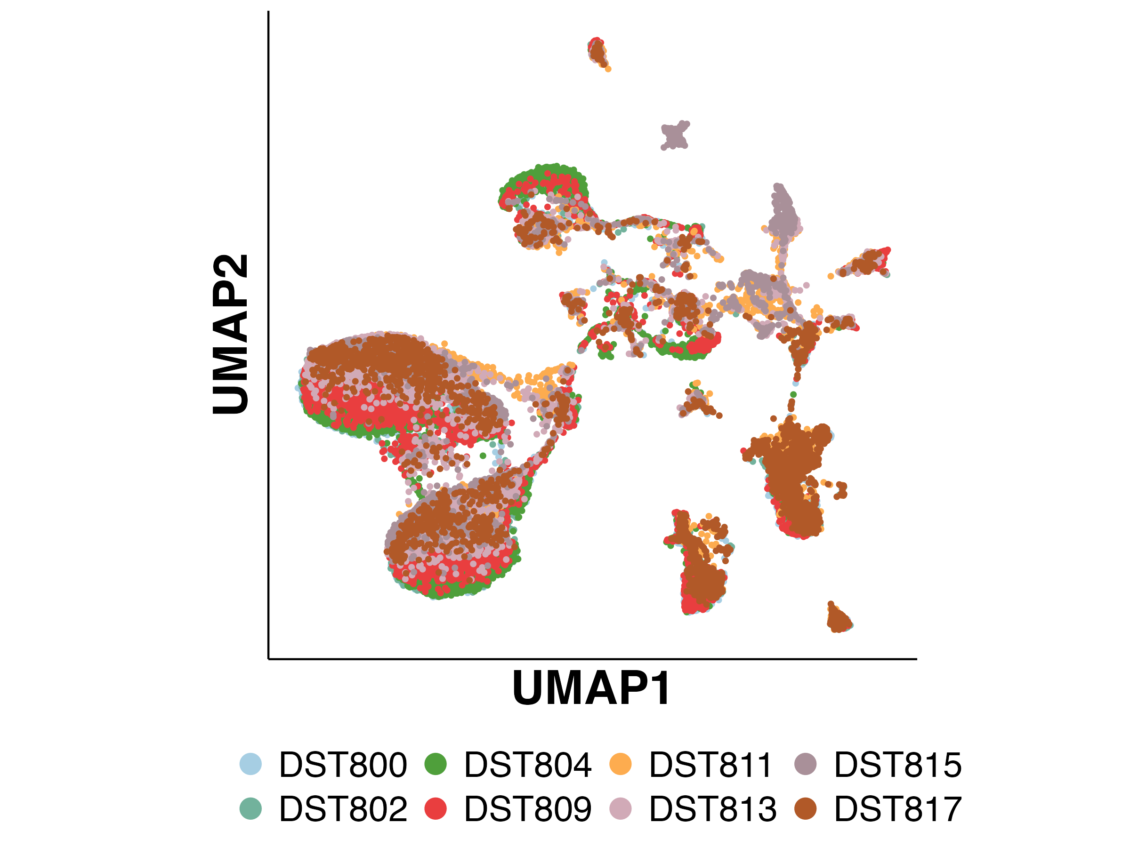
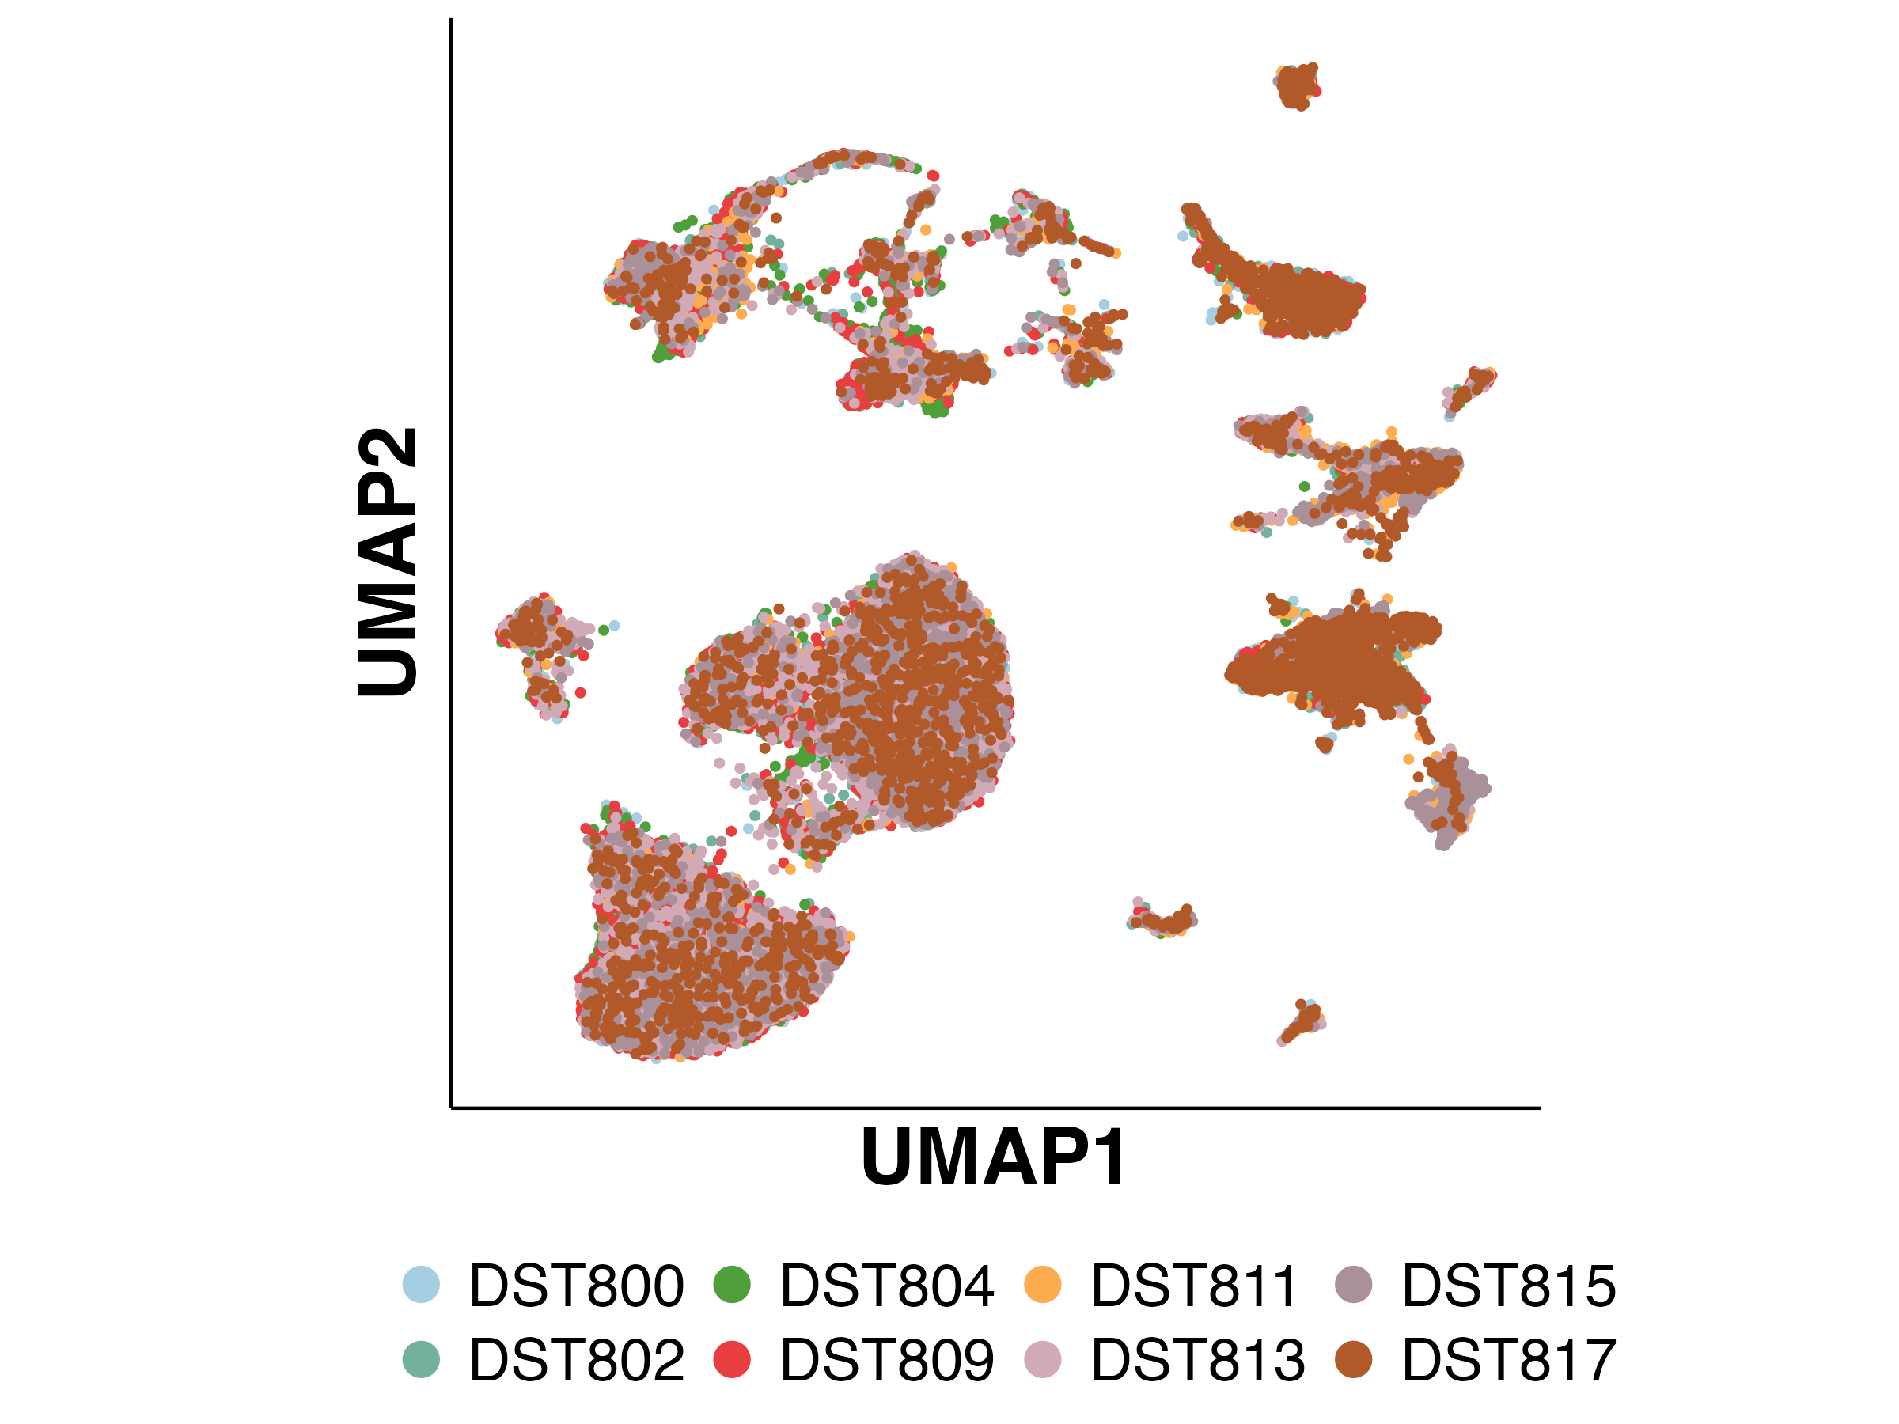
When analyzing multiple samples, more sophisticated integration methods may be used (e.g. Harmony)
Notes:
If there are multiple samples, are they integrating well?
Look for rainbow effect -> indicating need for better integration
E.g. using Harmony Integration method

Slide 35
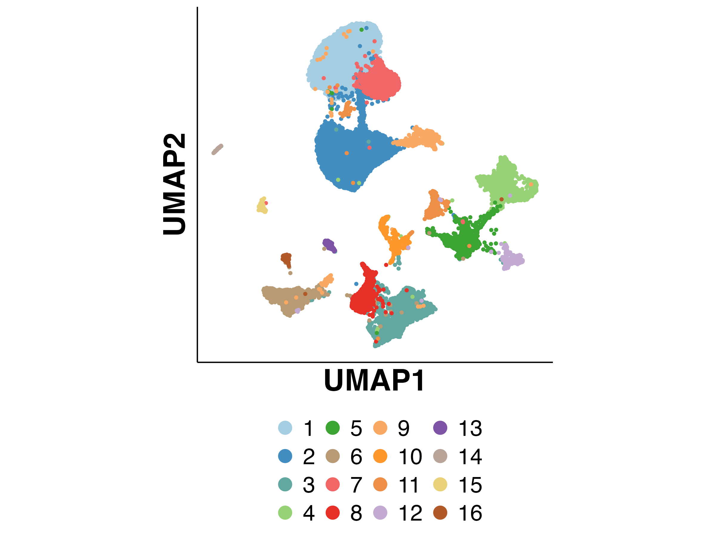
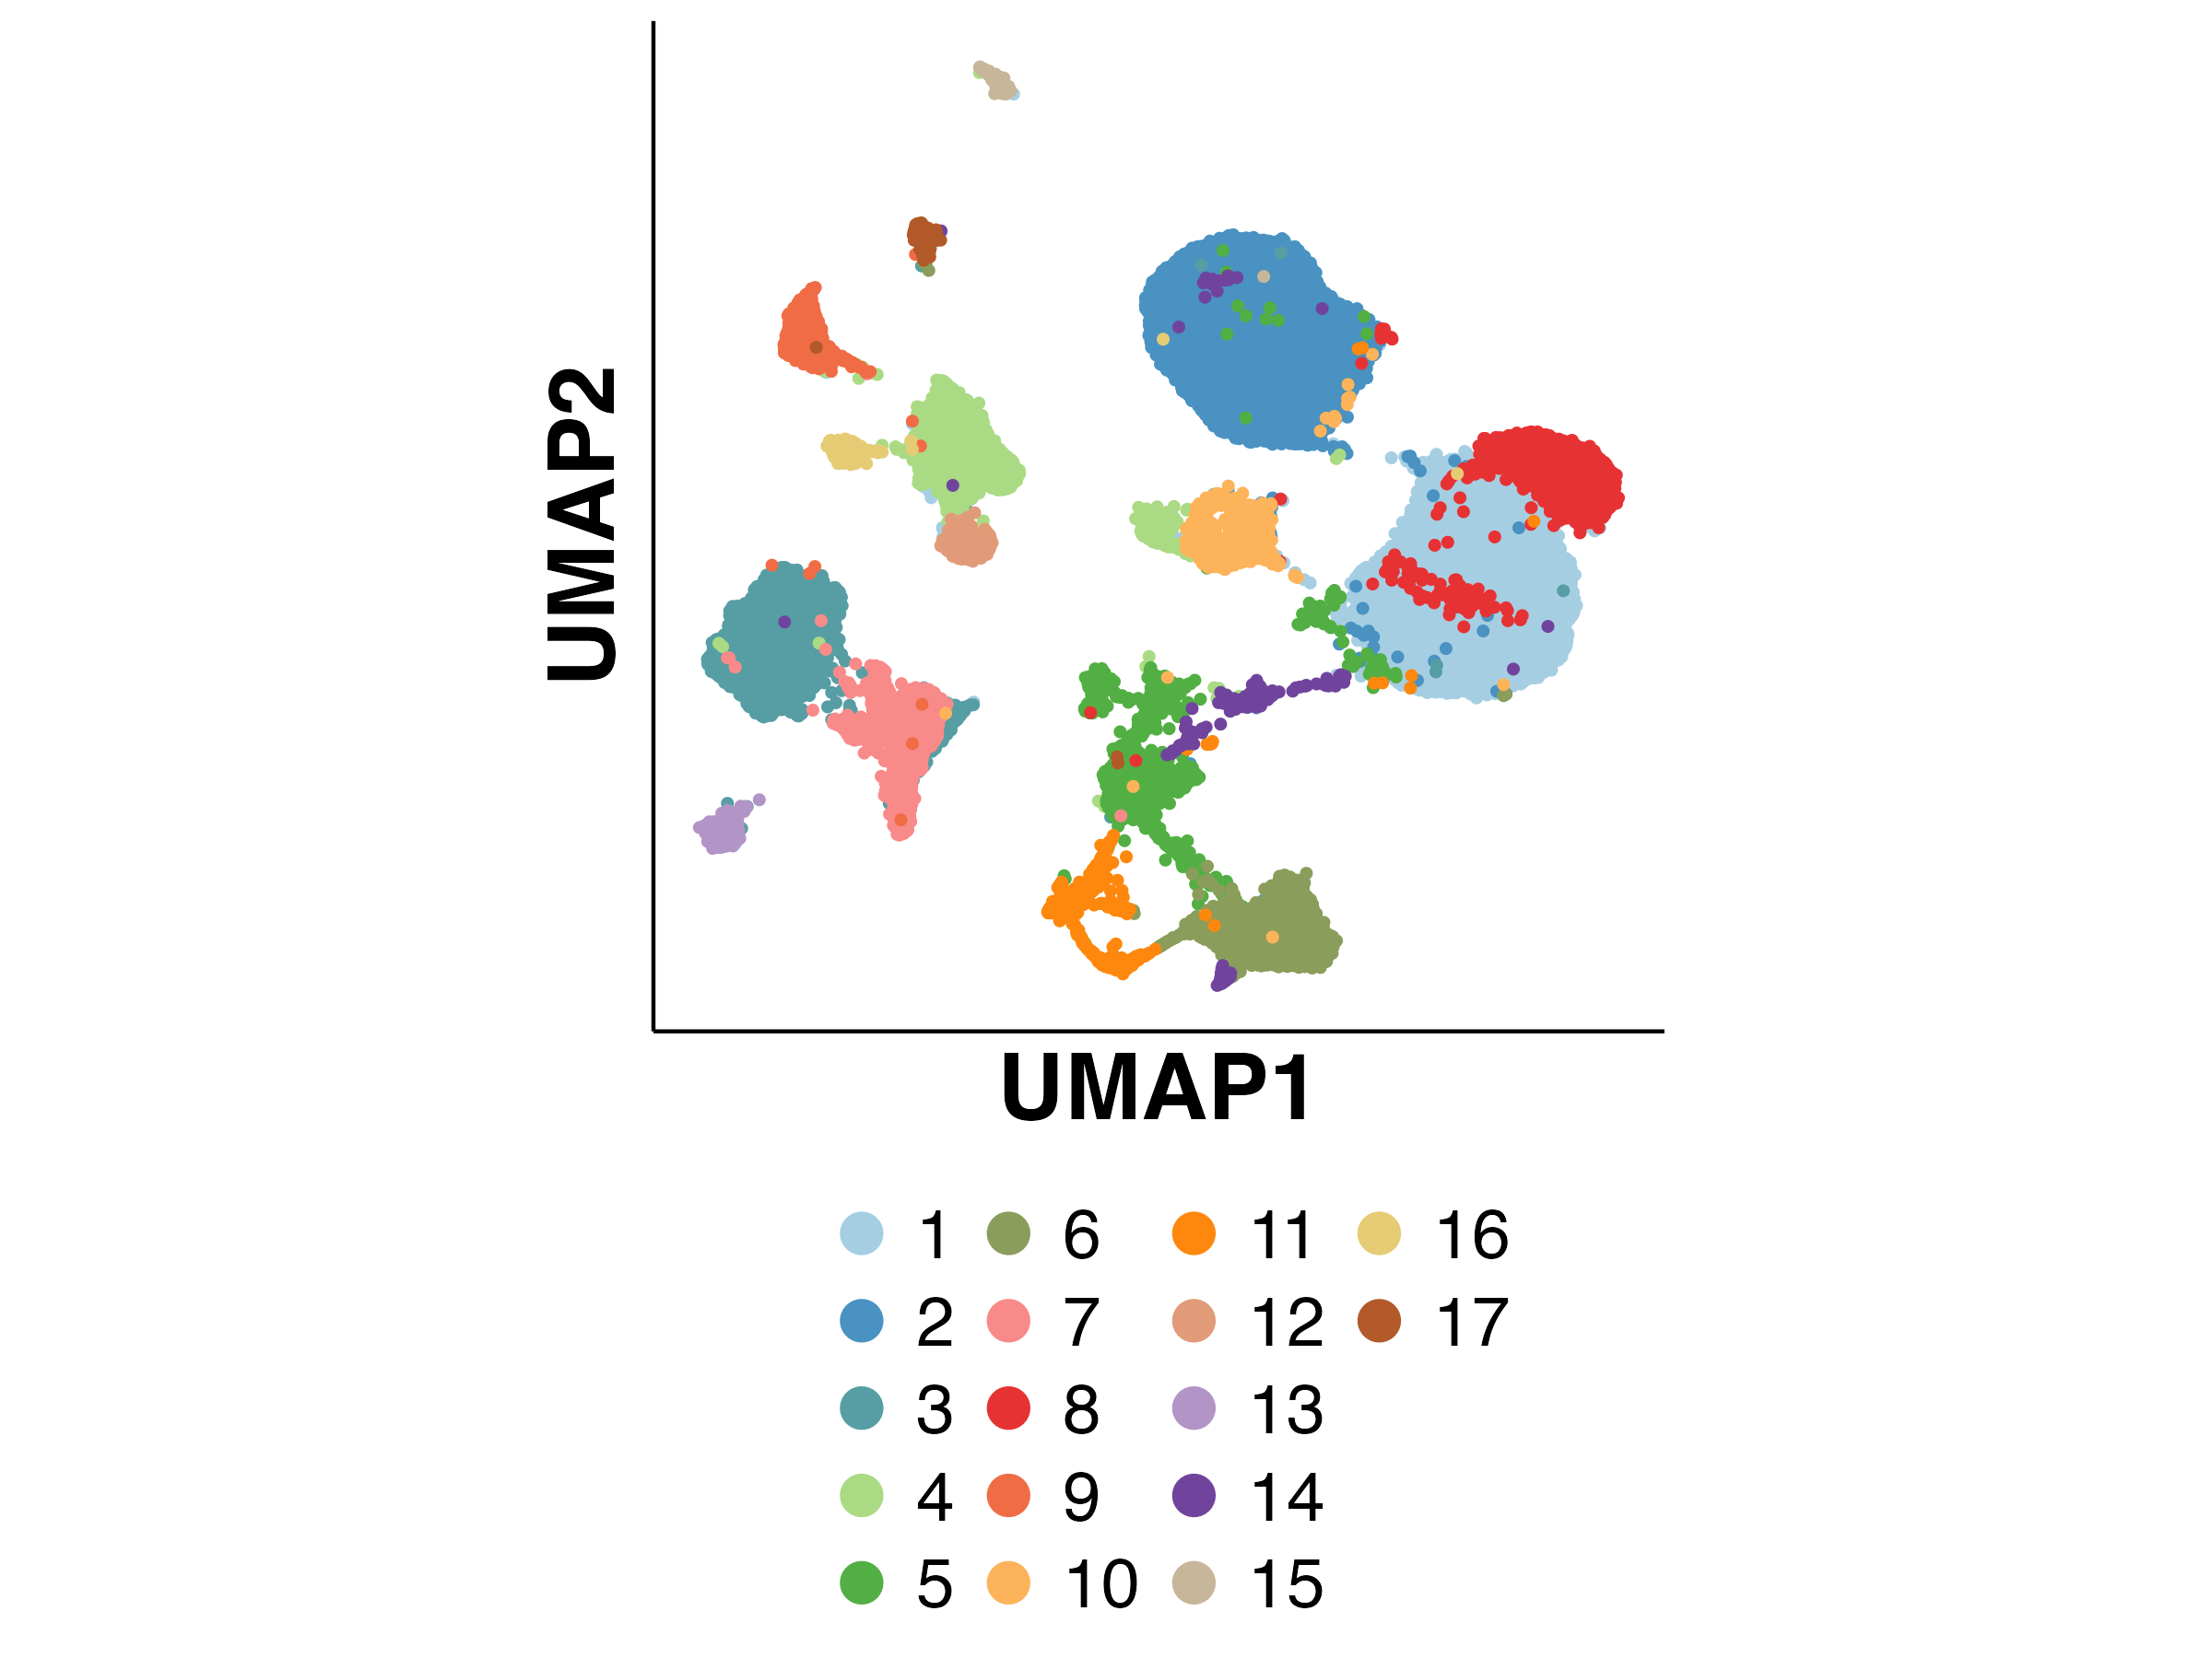
Some samples may need to be corrected for ambient RNA contamination (e.g. SoupX)
Notes:
Is there evidence of strong ambient RNA contamination?
Spider webbing in clustering
Run tool like SoupX to estimated, correct for contamination
Will not entirely remove spiderwebbing necessarily, there may be technical limitations in distinguishing markers or cells may have transition or intermediate gene expression

Slide 36
General analysis steps with Seurat (and other tools)

Slide 37
Once preparation of ”final” gene-barcode matrix, clustering is completed, common analysis steps include:
Cell typing
Based on curated marker expression, DE genes
Module scoring method
Automated methods comparing to reference expression profiles (e.g. SingleR)
Reference label transfer (mapping your data onto a labeled reference data set containing cell types you expect in your data)
Differential expression
Comparing clusters or cell types
Comparing conditions or phenotypes
Comparing timepoints
Sub-clustering of specific clusters, subsets of cells
E.g. if you want to separate out more subtly cell types or subtypes
Pseudotime or trajectory analysis
Position cells across spectrum of time or differentiation stage (for example)
See how expression profiles changes across time/stage
See how distribution of cell types changes over time/stage
Notes:
Can reach out to Bioinformatics Core for help with projects, analysis, bioinformatics questions

Slide 38
Questions?

Slide 39
Break for lunch

Slide 40
Visualization of sc/snRNA-seq with
R Shiny (ShinyCell)

Slide 41
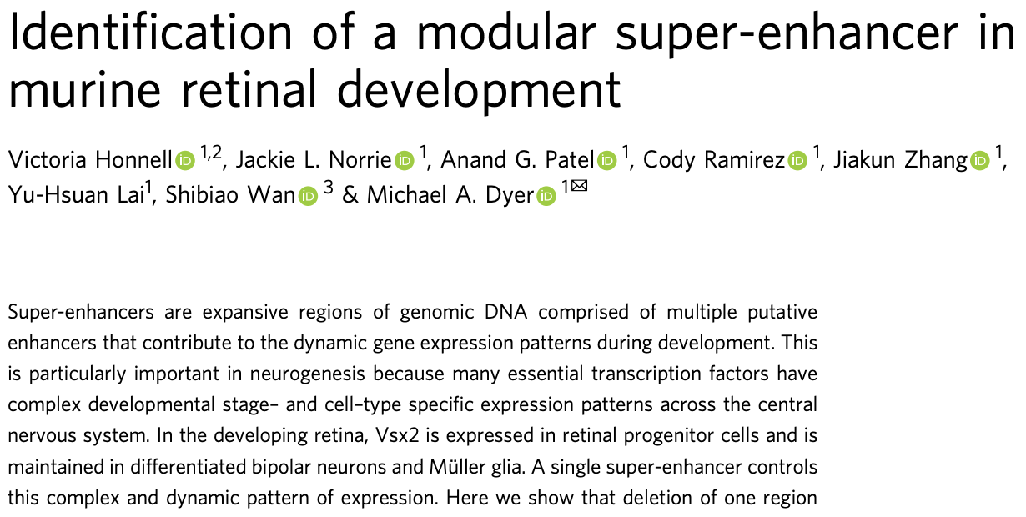
Exploring a retinal scRNA-seq dataset using R Shiny app
Looking at core regulatory circuit super enhancer (CRC-SE) for Vsx2
Vsx2 expressed in retinal progenitor cells
Vsx2 expressed in differentiated bipolar cells, Muller glia
Deleted 32kb region of CRC-SE
Deleted subregions to identify specific effects
Performed multi-omic analysis
Including scRNA-seq of retinal cell populations
https://vsx2-deletion.stjude.org/
Notes:
https://doi.org/10.1038/s41467-021-27924-y
CRC-SE means the SE contains binding sites for the gene it regulates, i.e. it contains (multiple) binding sites for Vsx2

Slide 42
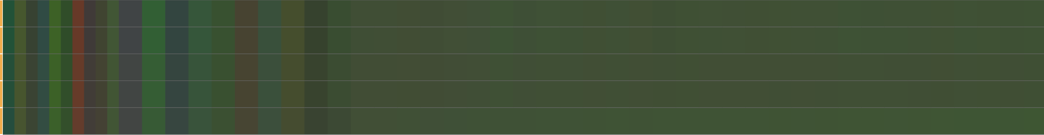
These are examples of good sequencing of bad or heavily degraded samples.
Per Base Sequence Content
Notes:
Passable vs bad aggregated per base sequence content

Slide 43
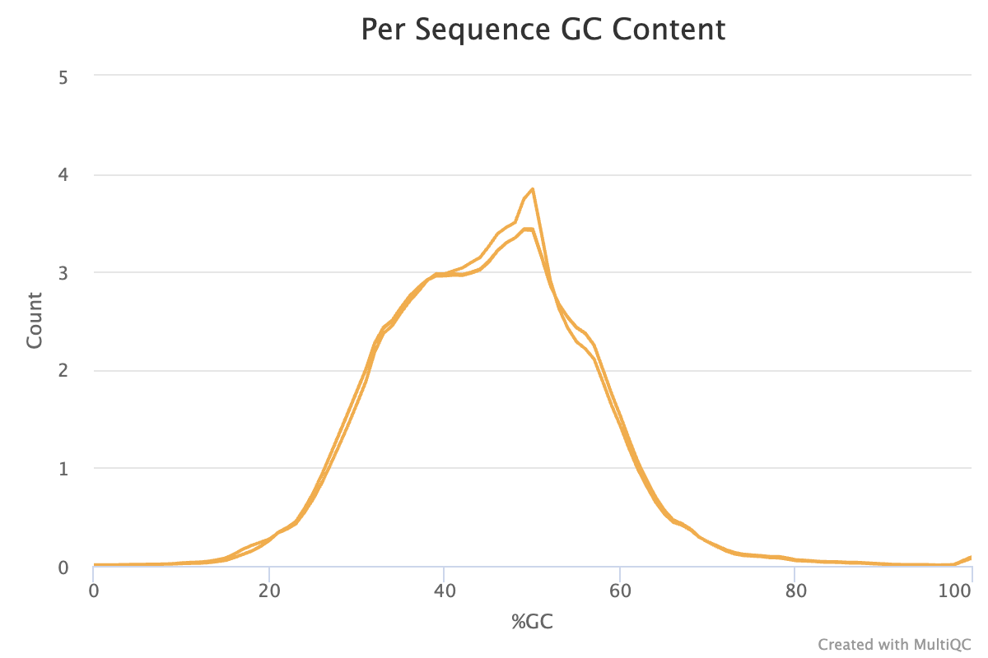
These are examples of good sequencing of bad or heavily degraded samples.
Notes:
Passable vs bad GC content

Slide 44

These are examples of good sequencing of bad or heavily degraded samples.
Notes:
Passable vs bad sequence duplication levels

Slide 45

These are examples of good sequencing of bad or heavily degraded samples.
Notes:
Passable vs bad overrepresented sequences levels

